Slide 1
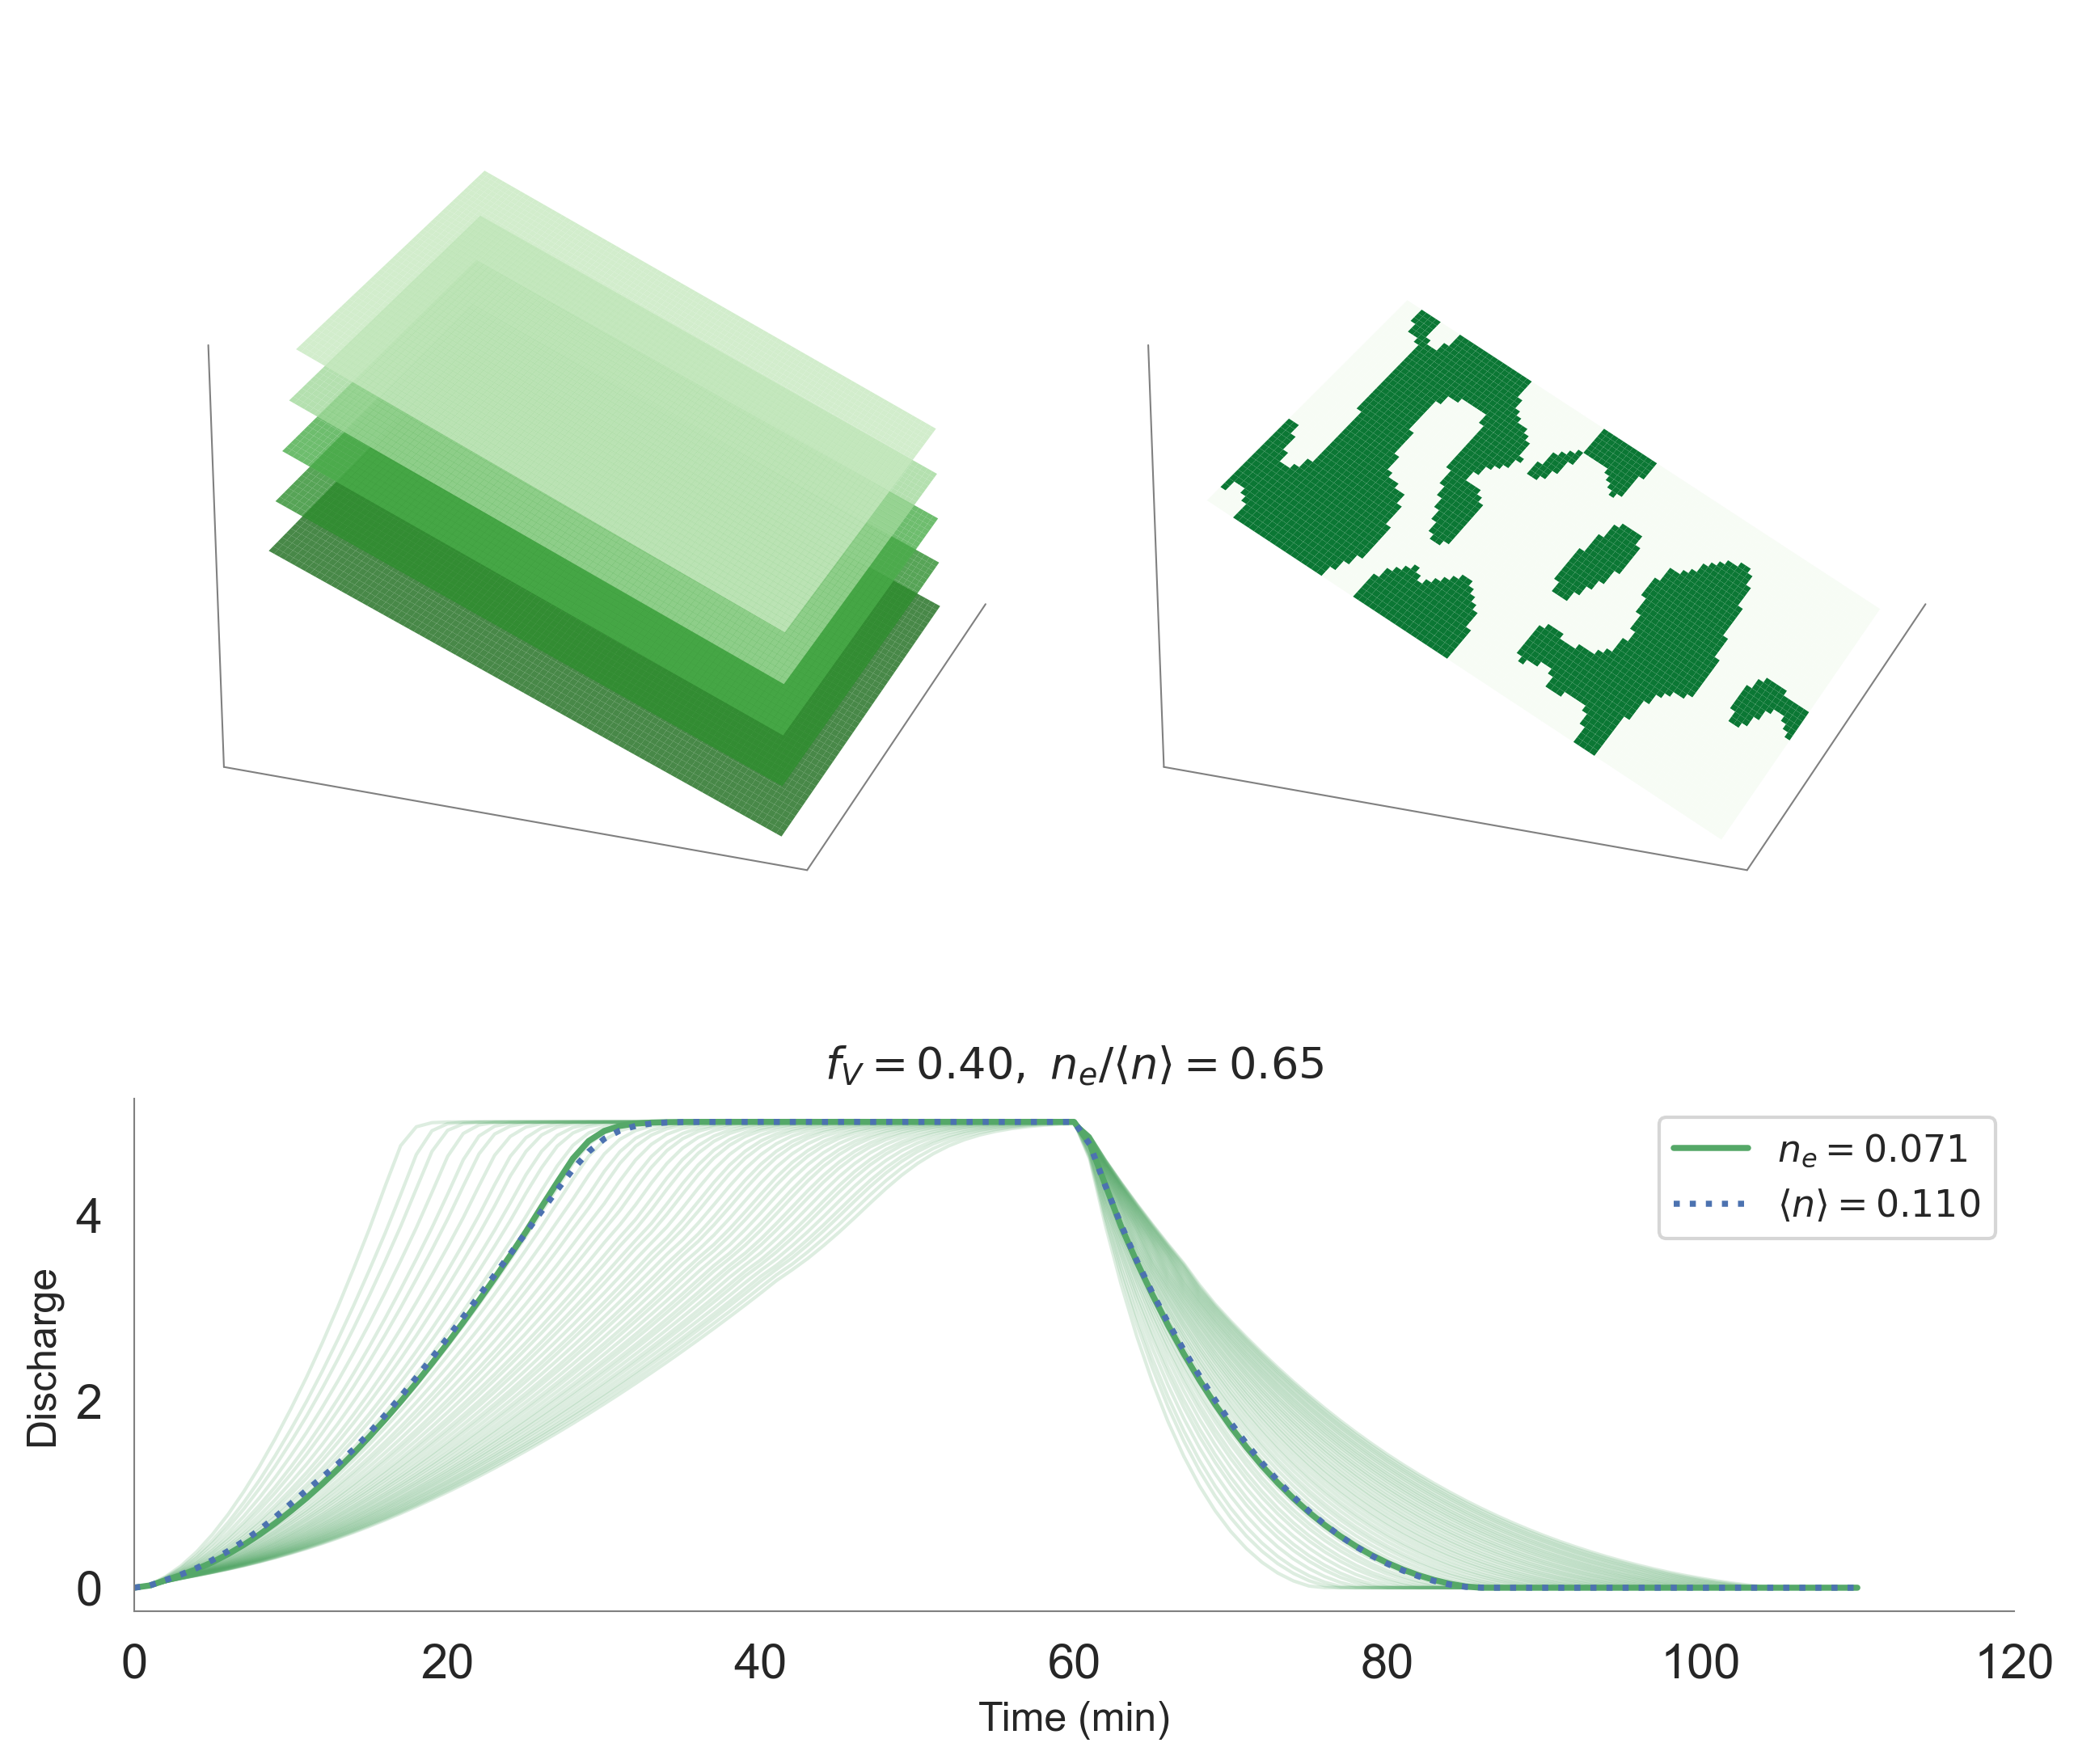
fV = 0.2 ,
fB = 0.05
fV = 0.4
ne = ?

Slide 2
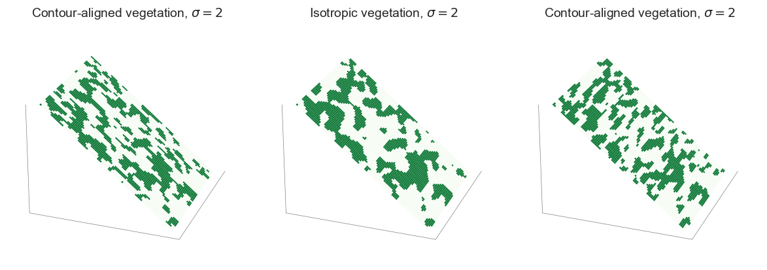

Slide 3
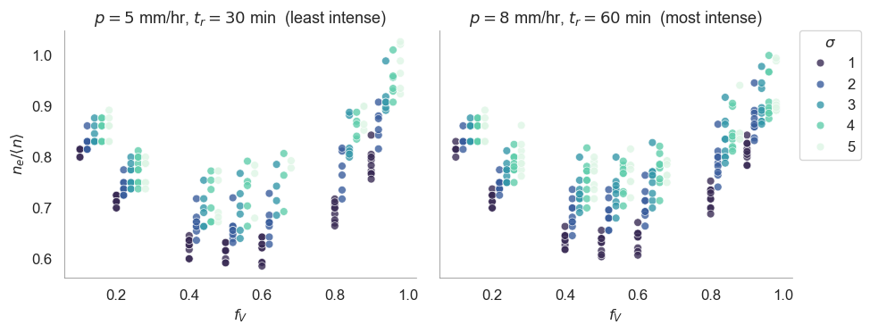
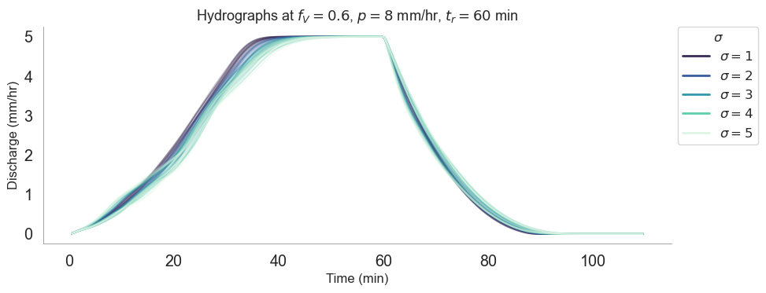
Increasing length-scale arrow
Make 2 by 2

Slide 4
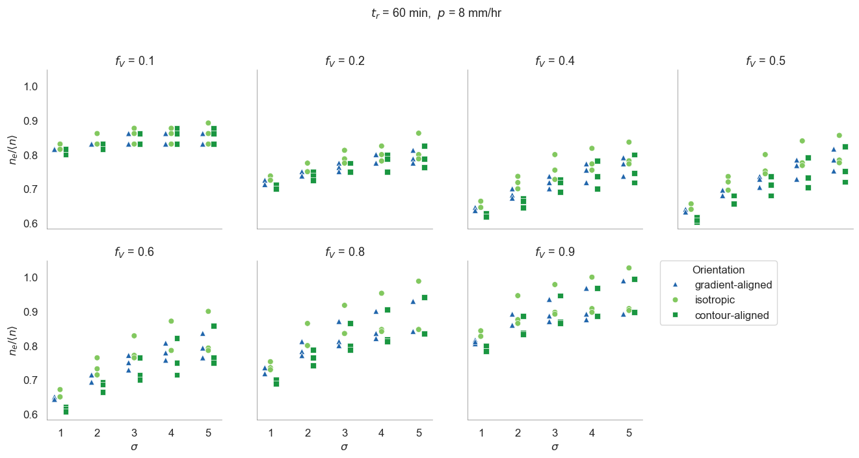

Slide 5
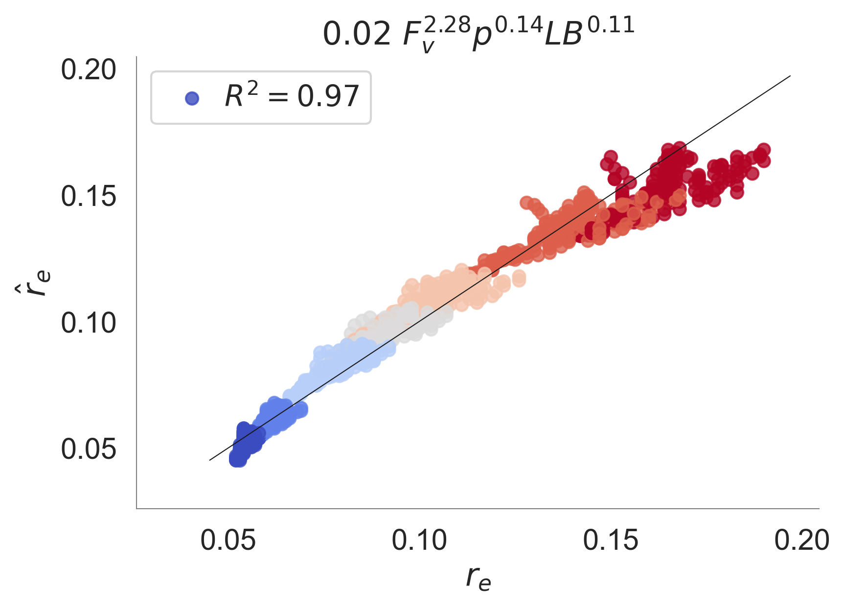
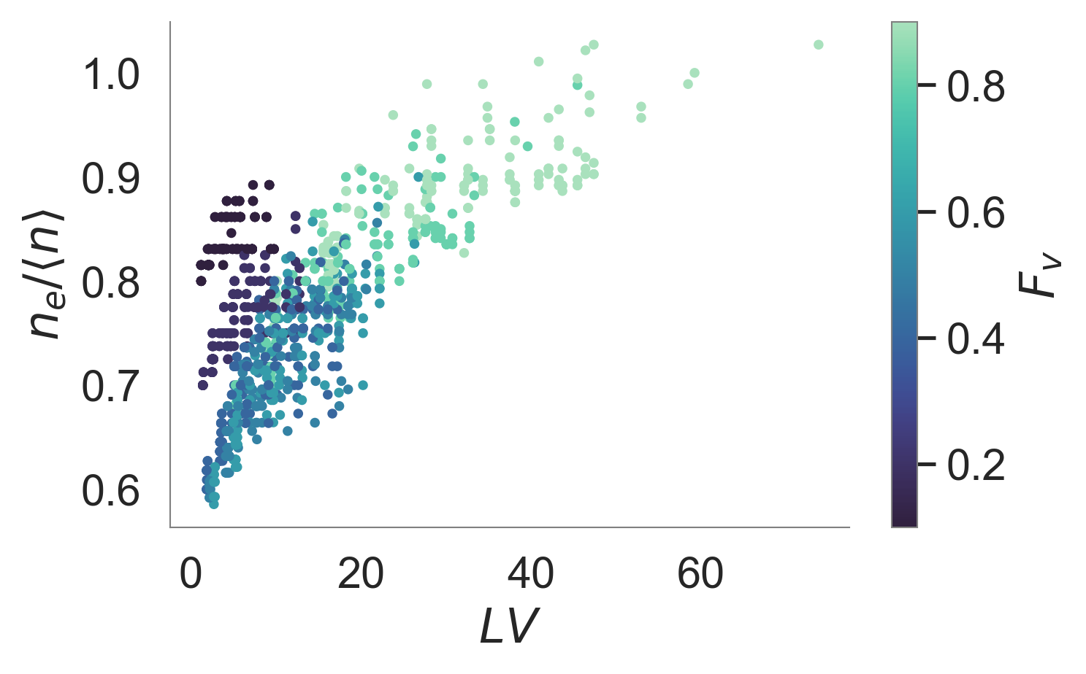

Slide 6
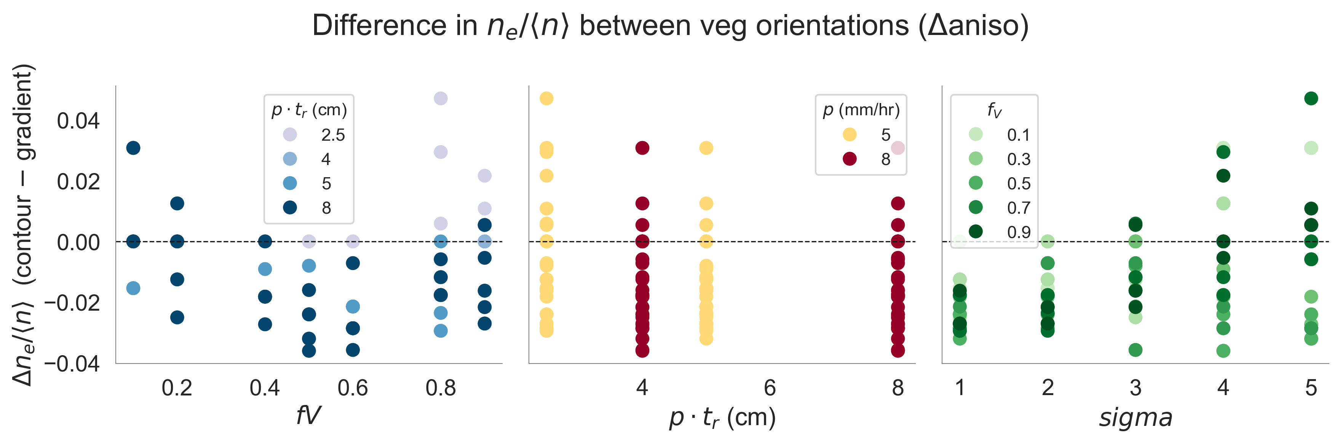

Slide 7
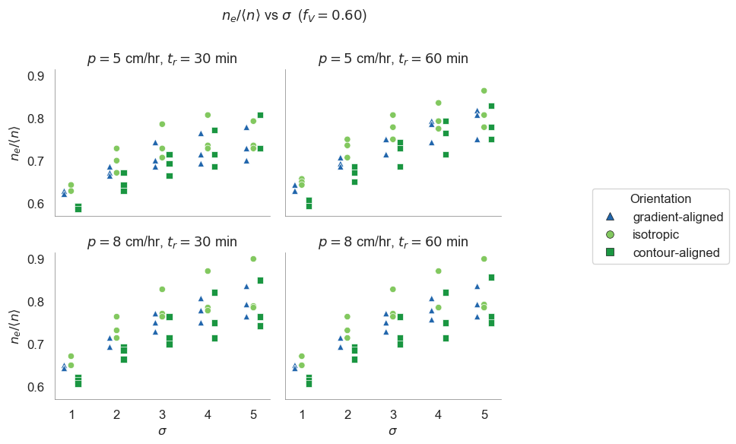

Slide 8
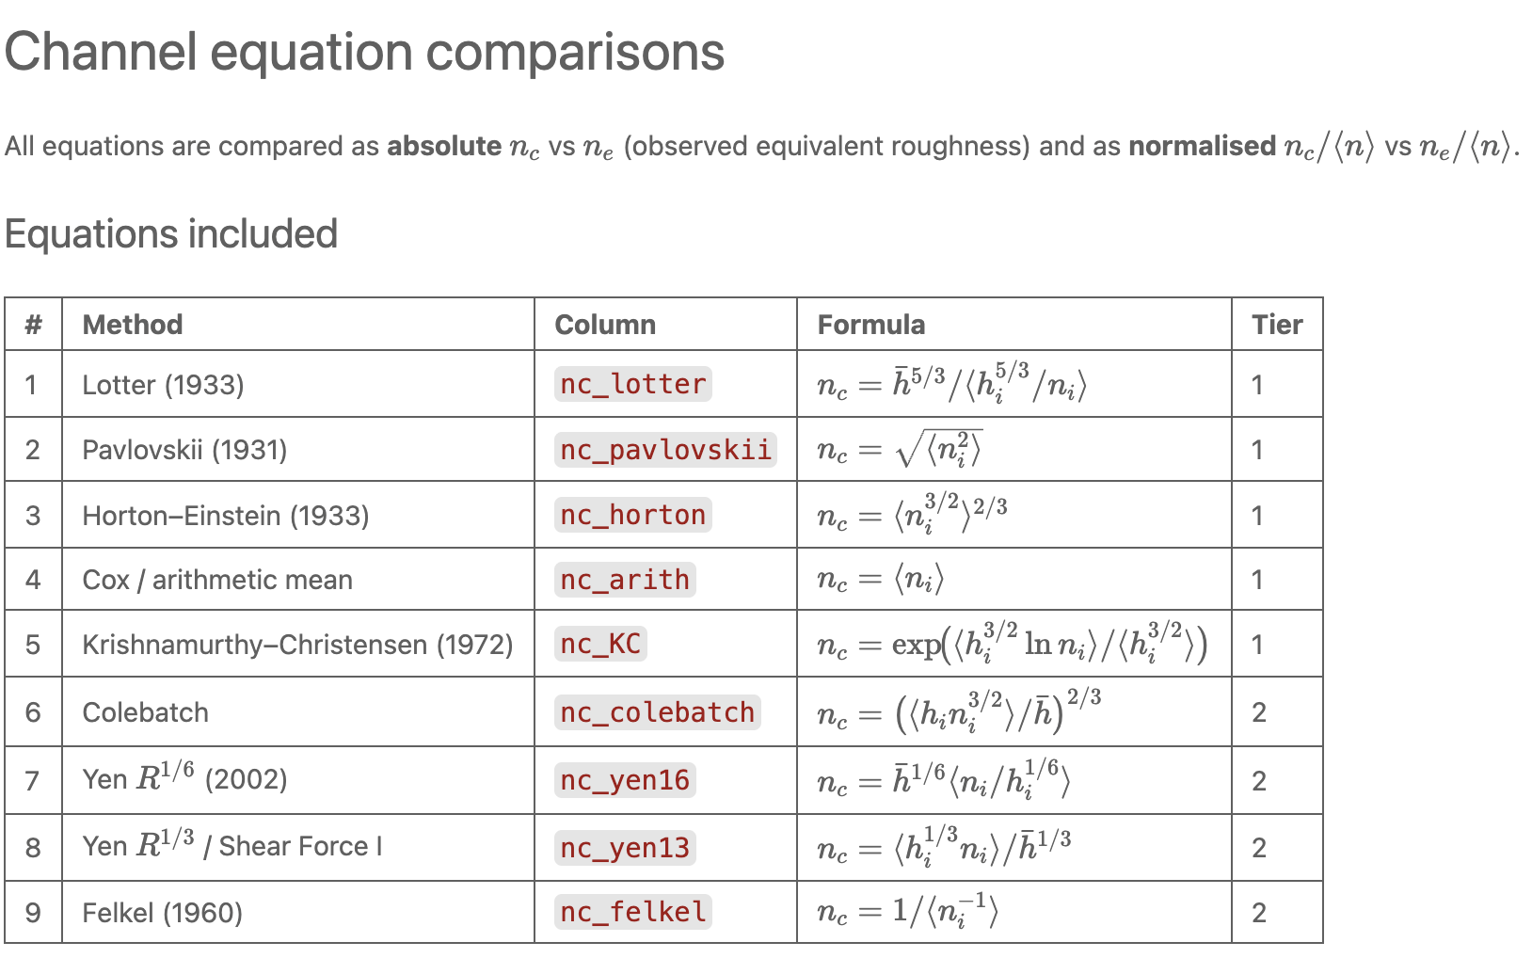

Slide 9
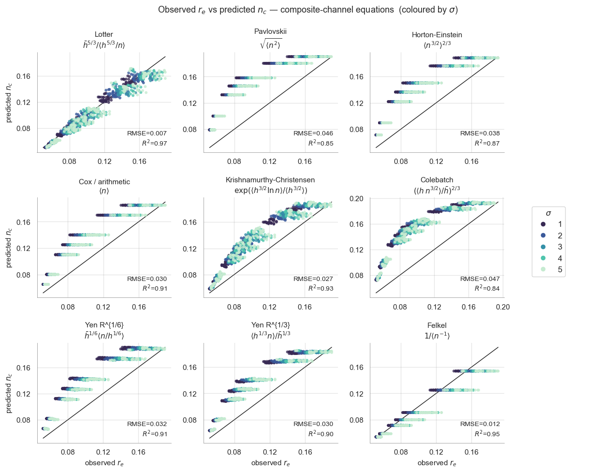

Slide 10
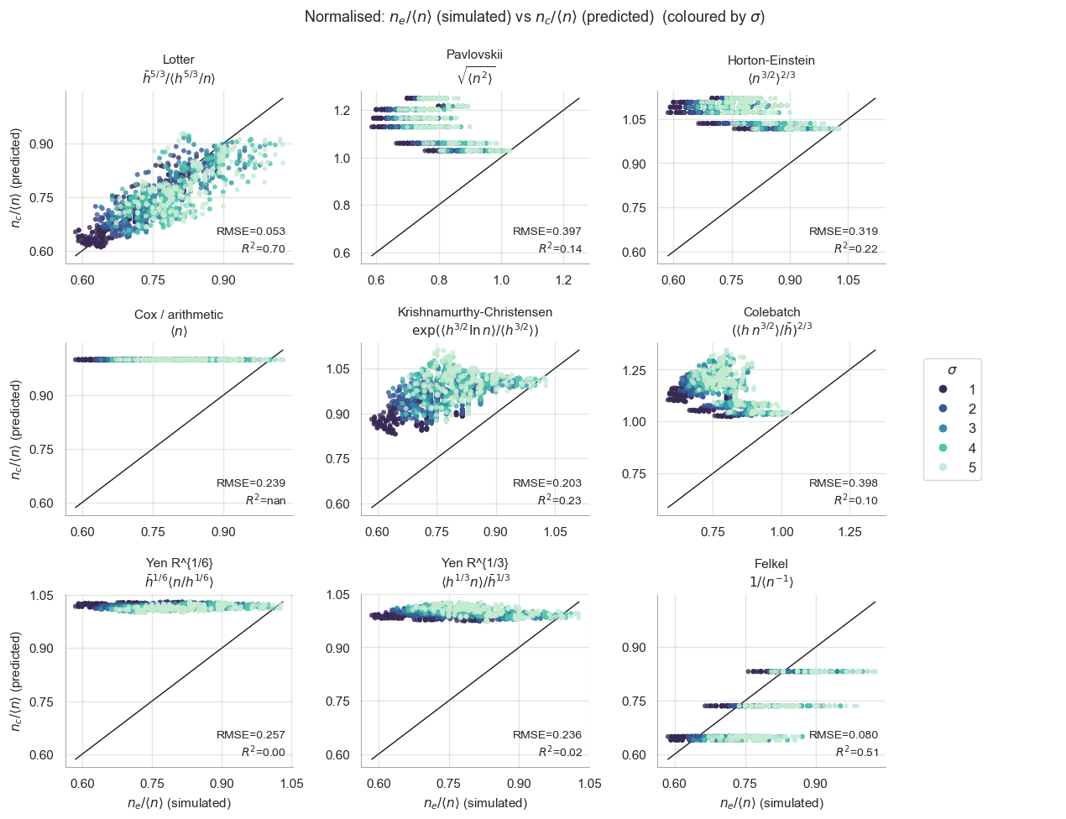

Slide 11
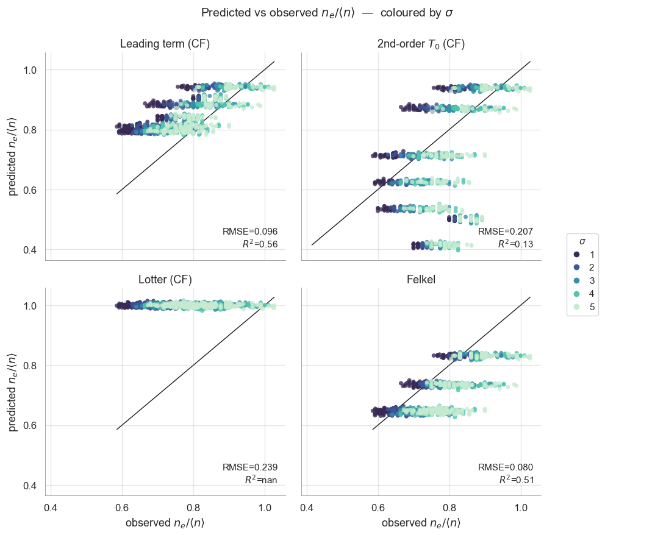

Slide 12
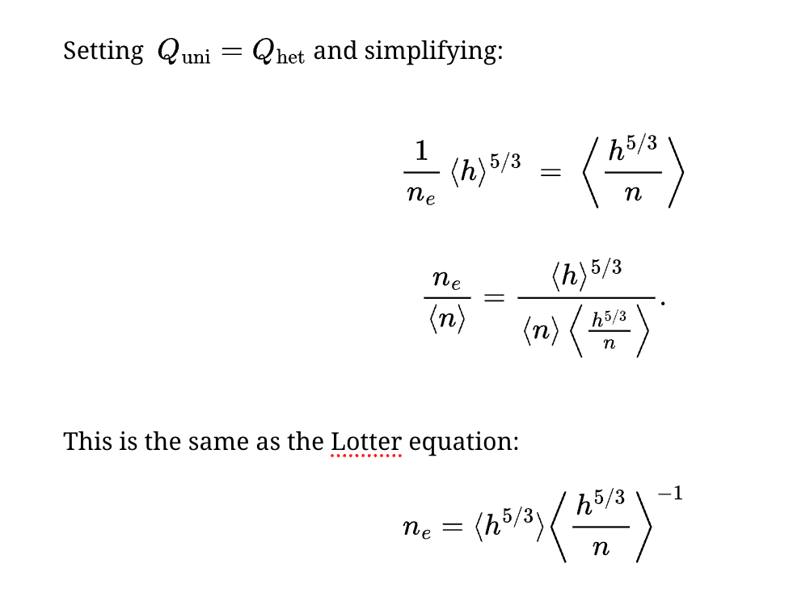
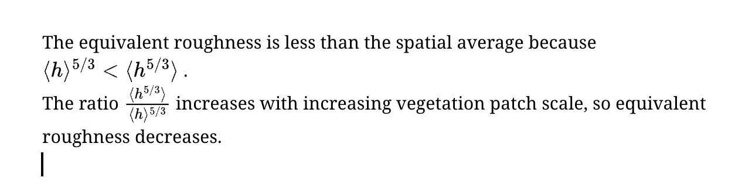

Slide 13
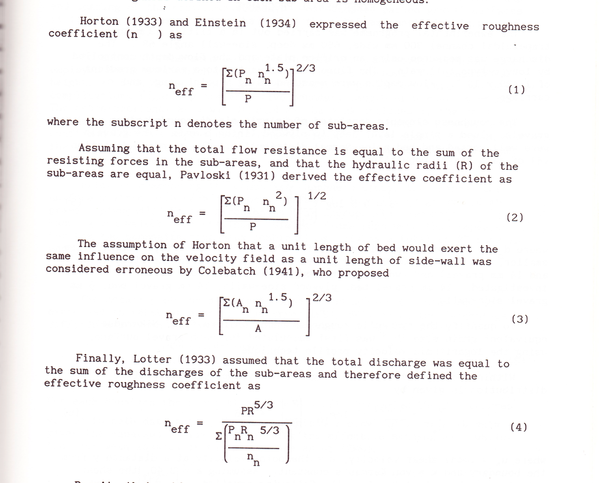
Flintham Carling 1989
Pavloski (1931)

Slide 14
Study | Year | Setting | Channel Type | Methods Tested
Motayed & Krishnamurthy | 1980 | Field — 36 gauged streams in 4 US states | Compound (natural rivers with floodplains) | Horton, Lotter, Krishnamurthy-Christensen, + 1 other
Yang, Cao & Liu (Acta Mech. Sinica) | 2005 | Laboratory — SERC Flood Channel Facility (UK) + collected field data | Symmetric compound channel, rough main channel & rough floodplains | Pavlovskii, Einstein-Banks, Lotter, Krishnamurthy-Christensen, Dracos-Hardegger, + others
Yang, Cao & Liu (Acta Mech. Sinica) | 2007 | Laboratory — large symmetric compound channel (Sichuan Univ.) + collected lab/field data | Symmetric compound, rough main channel & rough floodplains | Pavlovskii, Einstein-Banks, Lotter, Cox, Krishnamurthy-Christensen; vertical/horizontal/diagonal/bisectional subdivisions
Cao, Yang & Liu (IAHR) | 2006 | Laboratory + collected field data | Compound channels | Pavlovskii, Horton-Einstein-Banks, Lotter, Krishnamurthy-Christensen, Dracos-Hardegger
Djajadi | 2009 | Laboratory — 4m-long, 0.05m-wide trapezoidal prismatic channel | Composite (simple cross-section, not compound); different bed vs. sidewall roughness | Horton, Pavlovskii/Einstein-Banks, Lotter, Cox, Colebatch, Shear Force I (R^1/3), Shear Force II (R^1/6), Felkel, Linear P-weighted
Pradhan & Khatua (River Flow 2014) | 2014 | Laboratory — compound channels with differential roughness + FCF data | Non-homogeneous compound channels (straight) | Standard compositing methods (Horton, Pavlovskii, Lotter, Cox, etc.) + proposed modified method
Pradhan & Khatua (KSCE J. Civ. Eng.) | 2018 | Laboratory — meandering compound channel (sinuosity 4.11) + literature data from 297 runs | Meandering compound cahannels with floodplains | Existing models (Horton, Pavlovskii, Lotter, KCM, etc.) + proposed dimensional-analysis model
Yen (J. Hydraulic Engineering review) | 2002 | Theoretical review + example calculations | Compound/composite channels (general) | 17 different composite-n equations catalogued (Horton, Einstein-Banks, Pavlovskii, Lotter, Cox, Colebatch, KCM, Yen variants, Felkel, etc.)
McAtee (SunCam course) | 2012 | Didactic — worked examples on idealized compound channels | Symmetric compound channel with floodplains | Pavlovskii, Lotter, Horton, Colebatch, Cox, Krishnamurthy-Christensen, Yen (R^1/6), Segmented Conveyance
Ghareh Aghaji Zare et al. (Water Resources Research) | 2016 | Field — Lower Nelson River, Manitoba, Canada (ice-covered) | Ice-covered river (composite: bed + ice boundary) | Sabaneev, Pavlovskii, Lotter, Larsen, Uzuner, + proposed new approach
Pradhan et al. (J. Hydrology, NCRM) | 2024/2025 | Laboratory — UK FCF data + multiple lab datasets with differential roughness | Straight & meandering compound channels with varying roughness | Cox, Einstein-Banks, Lotter, Das-Khatua, + proposed NCRM

Slide 15
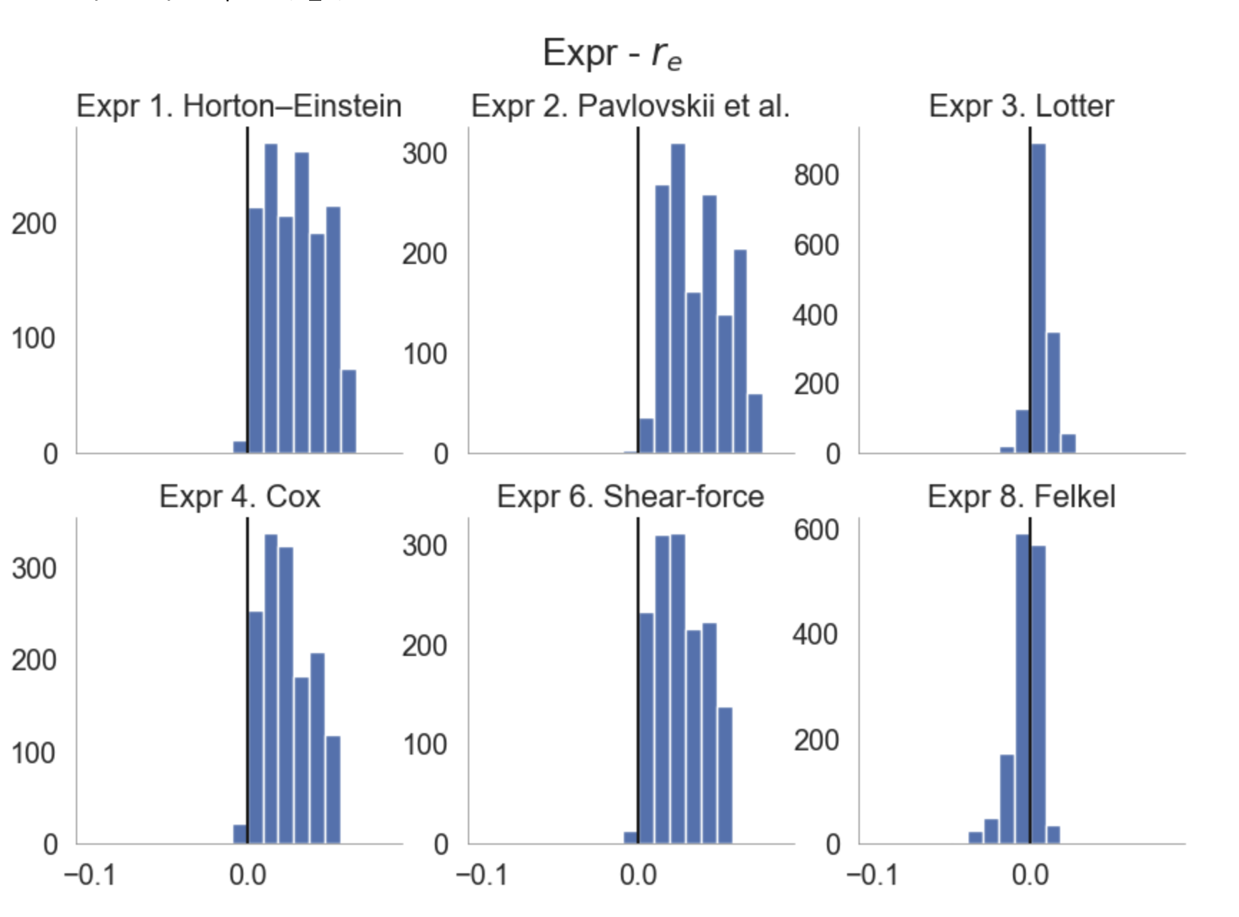

Slide 16
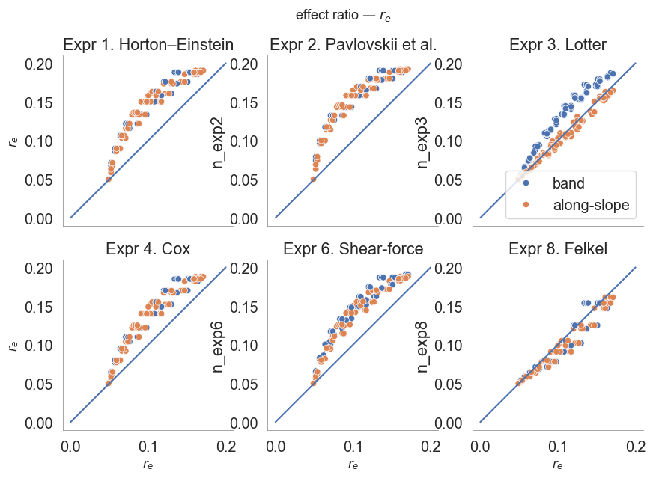

Slide 17
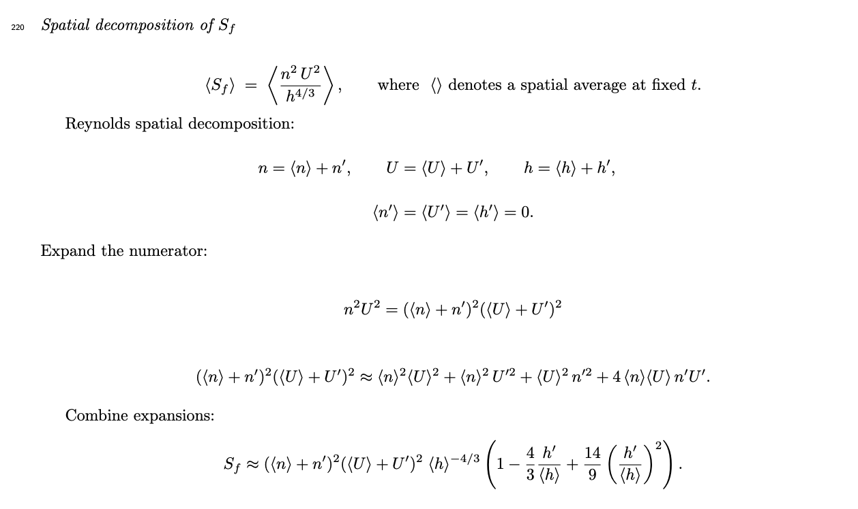

Slide 18
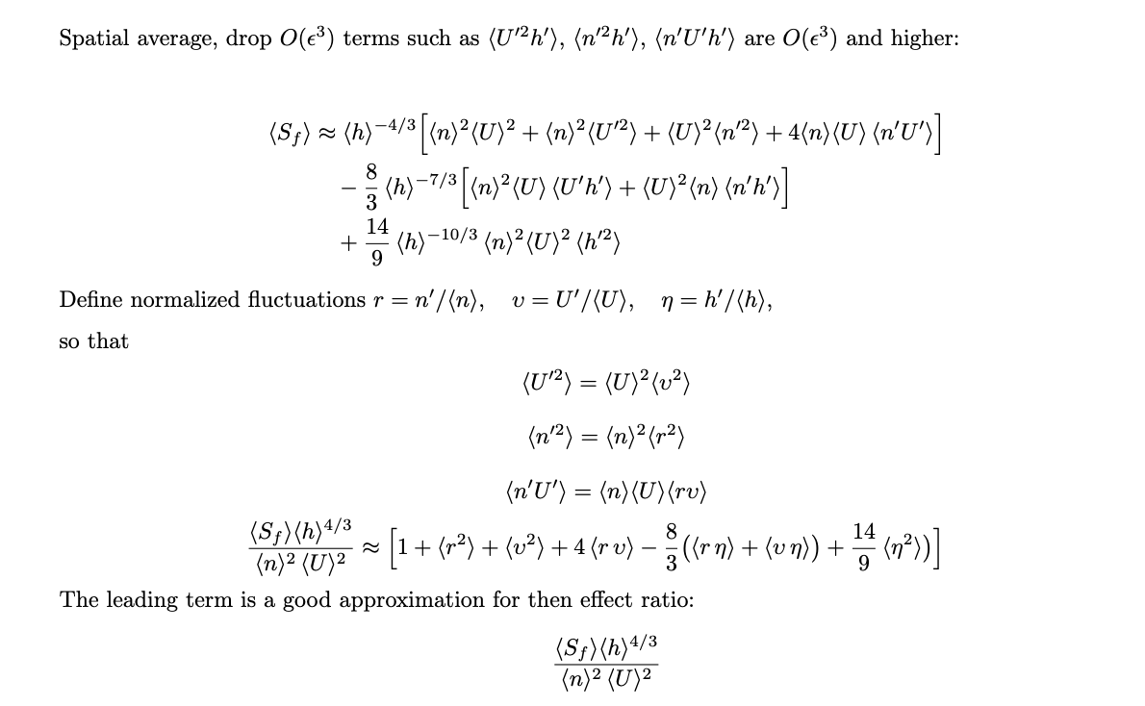

Slide 19
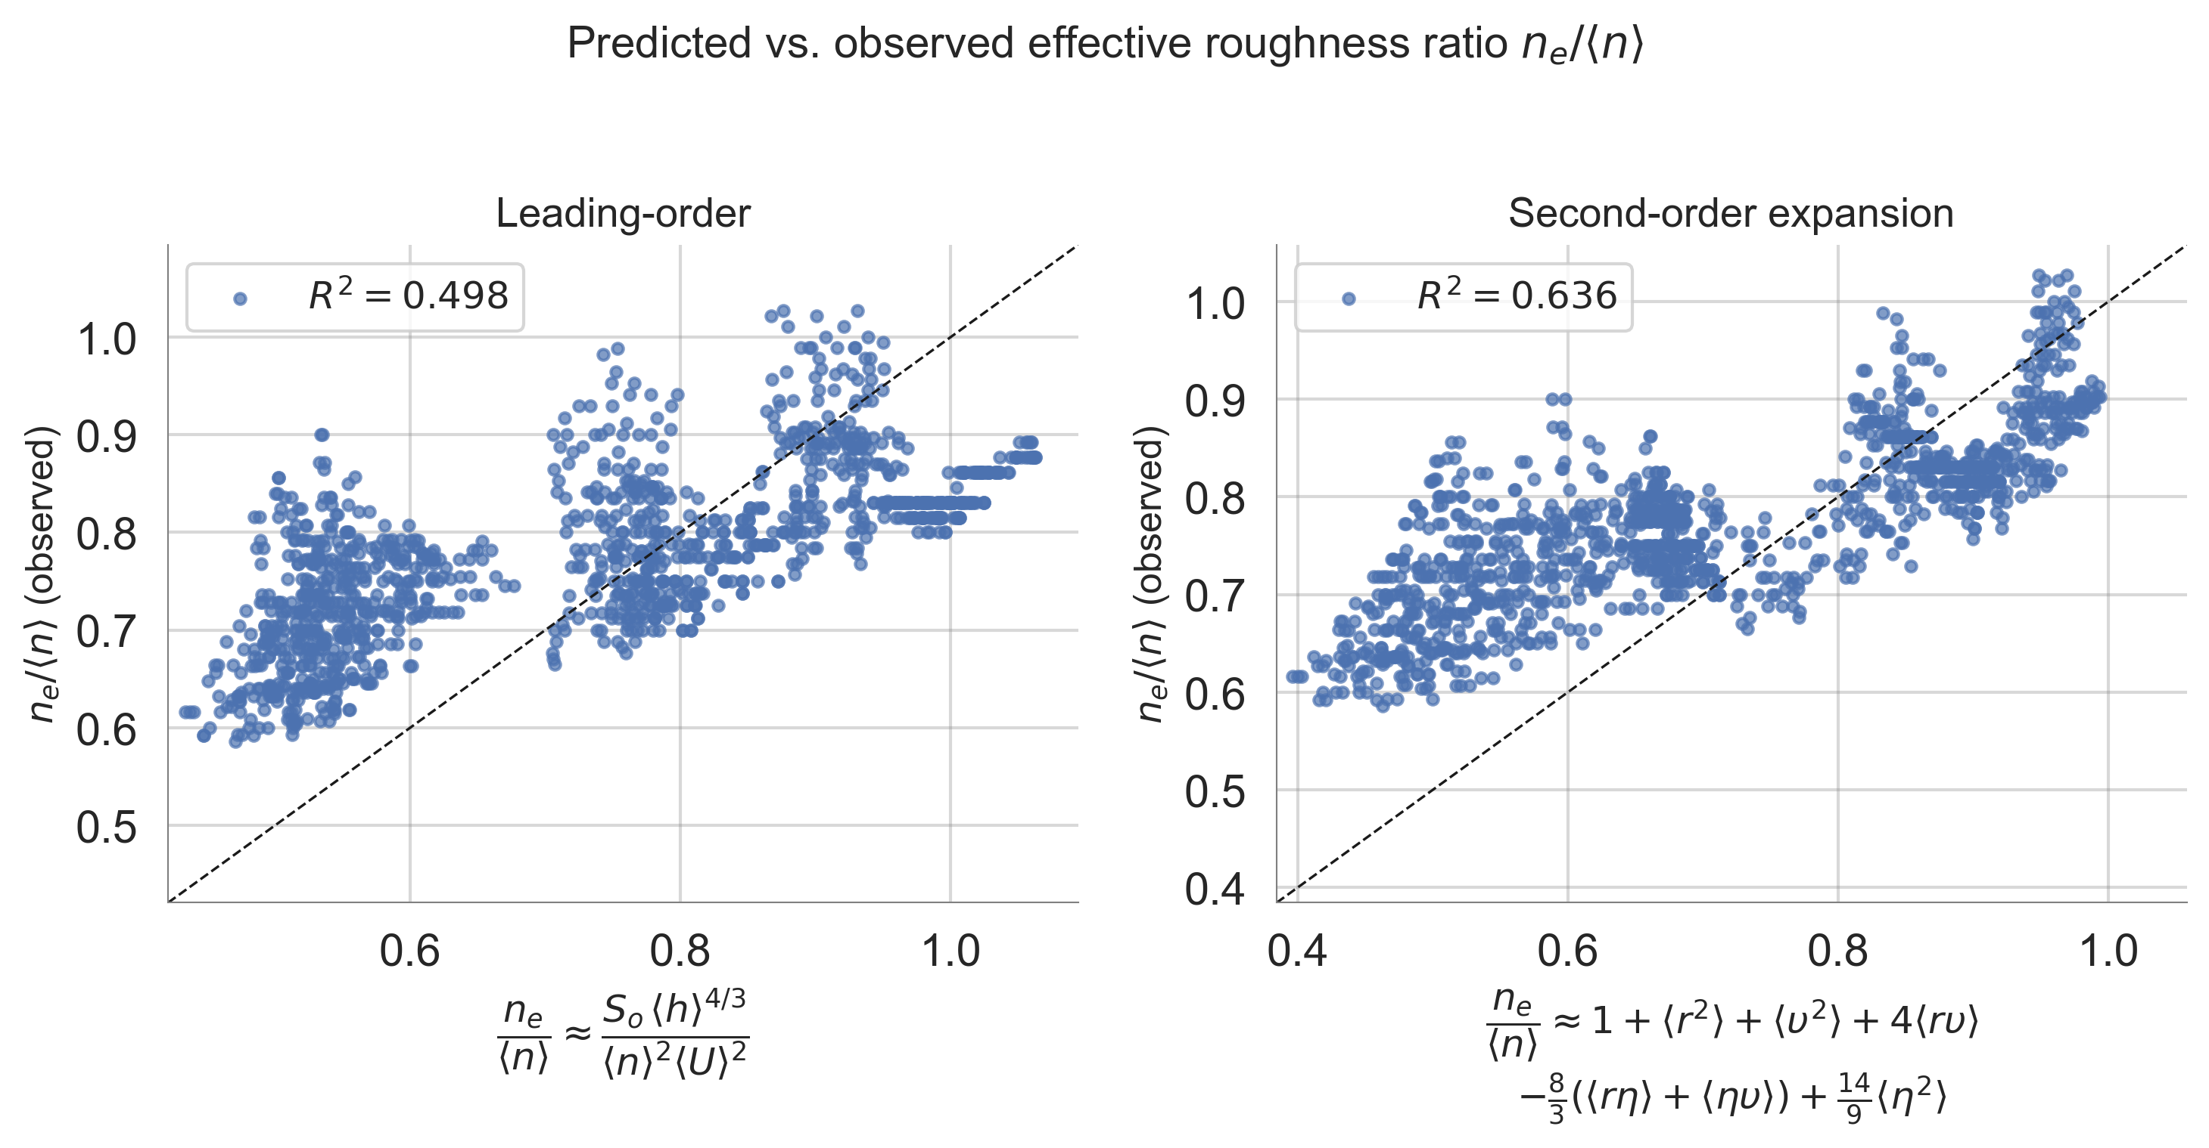

Slide 20
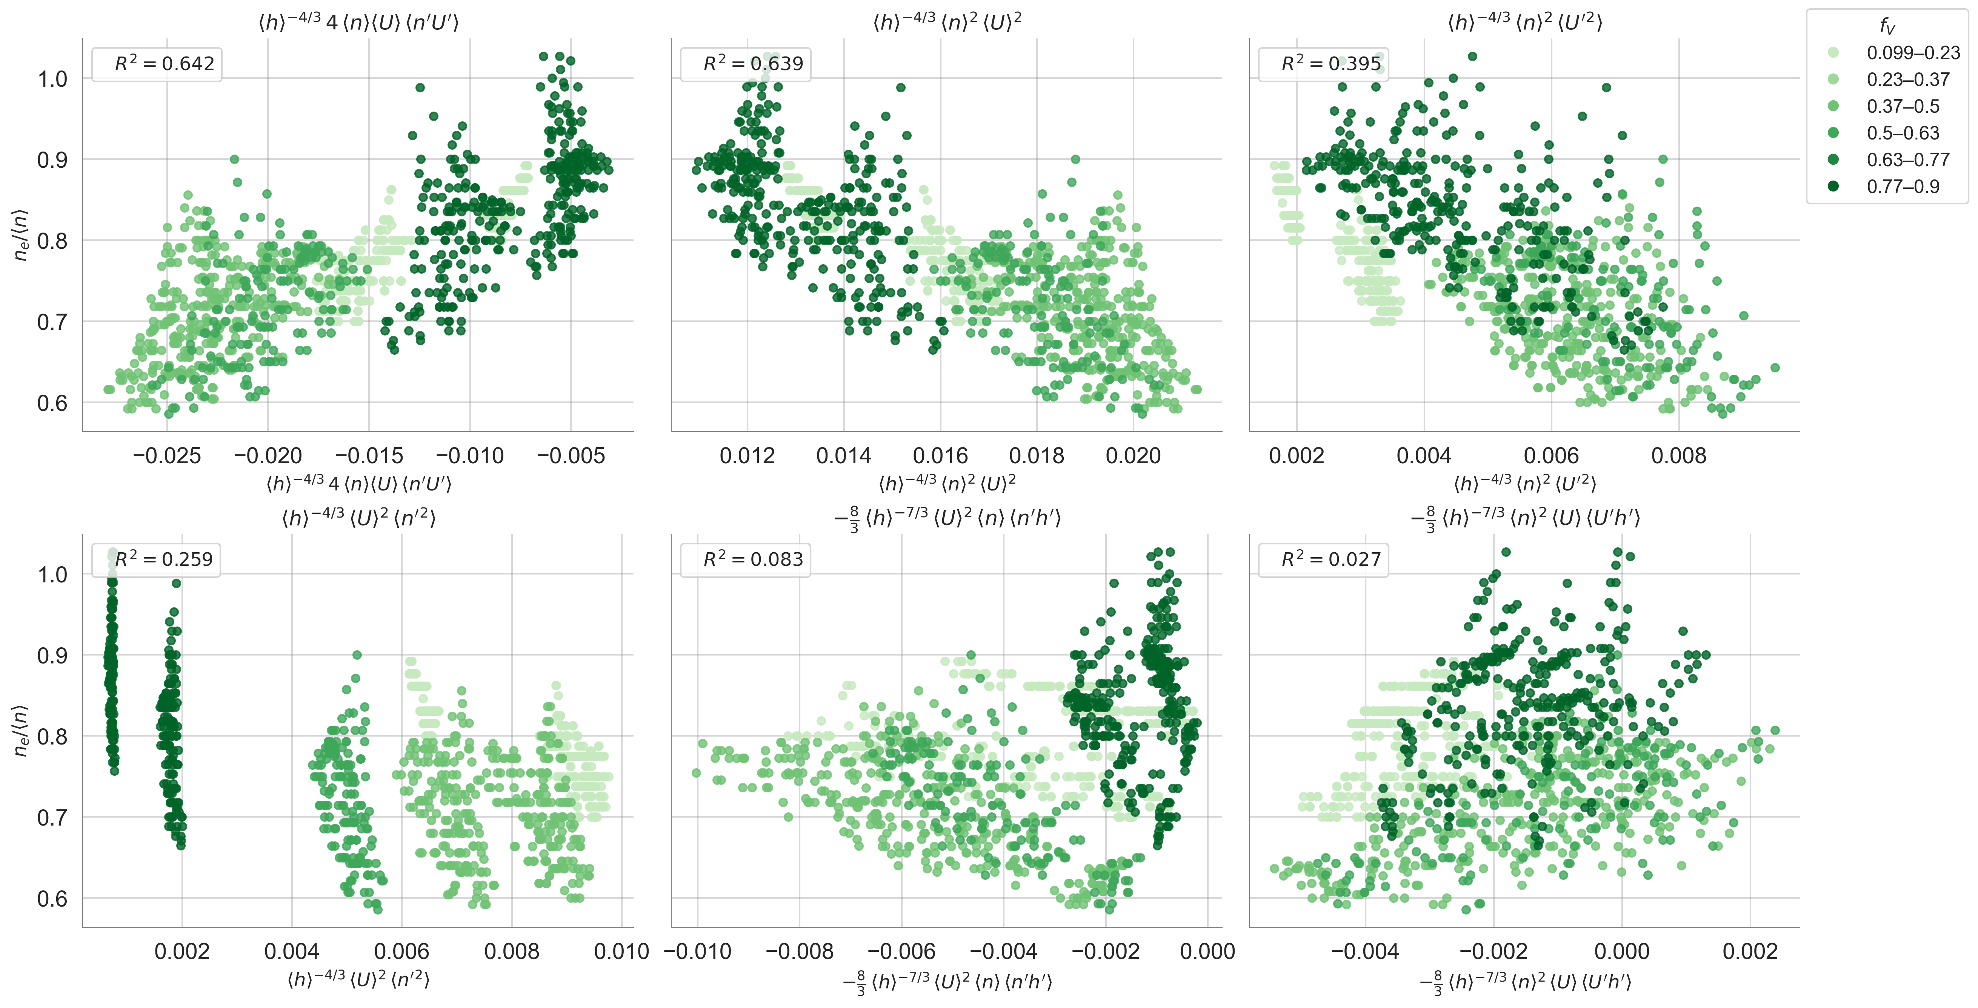

Slide 21
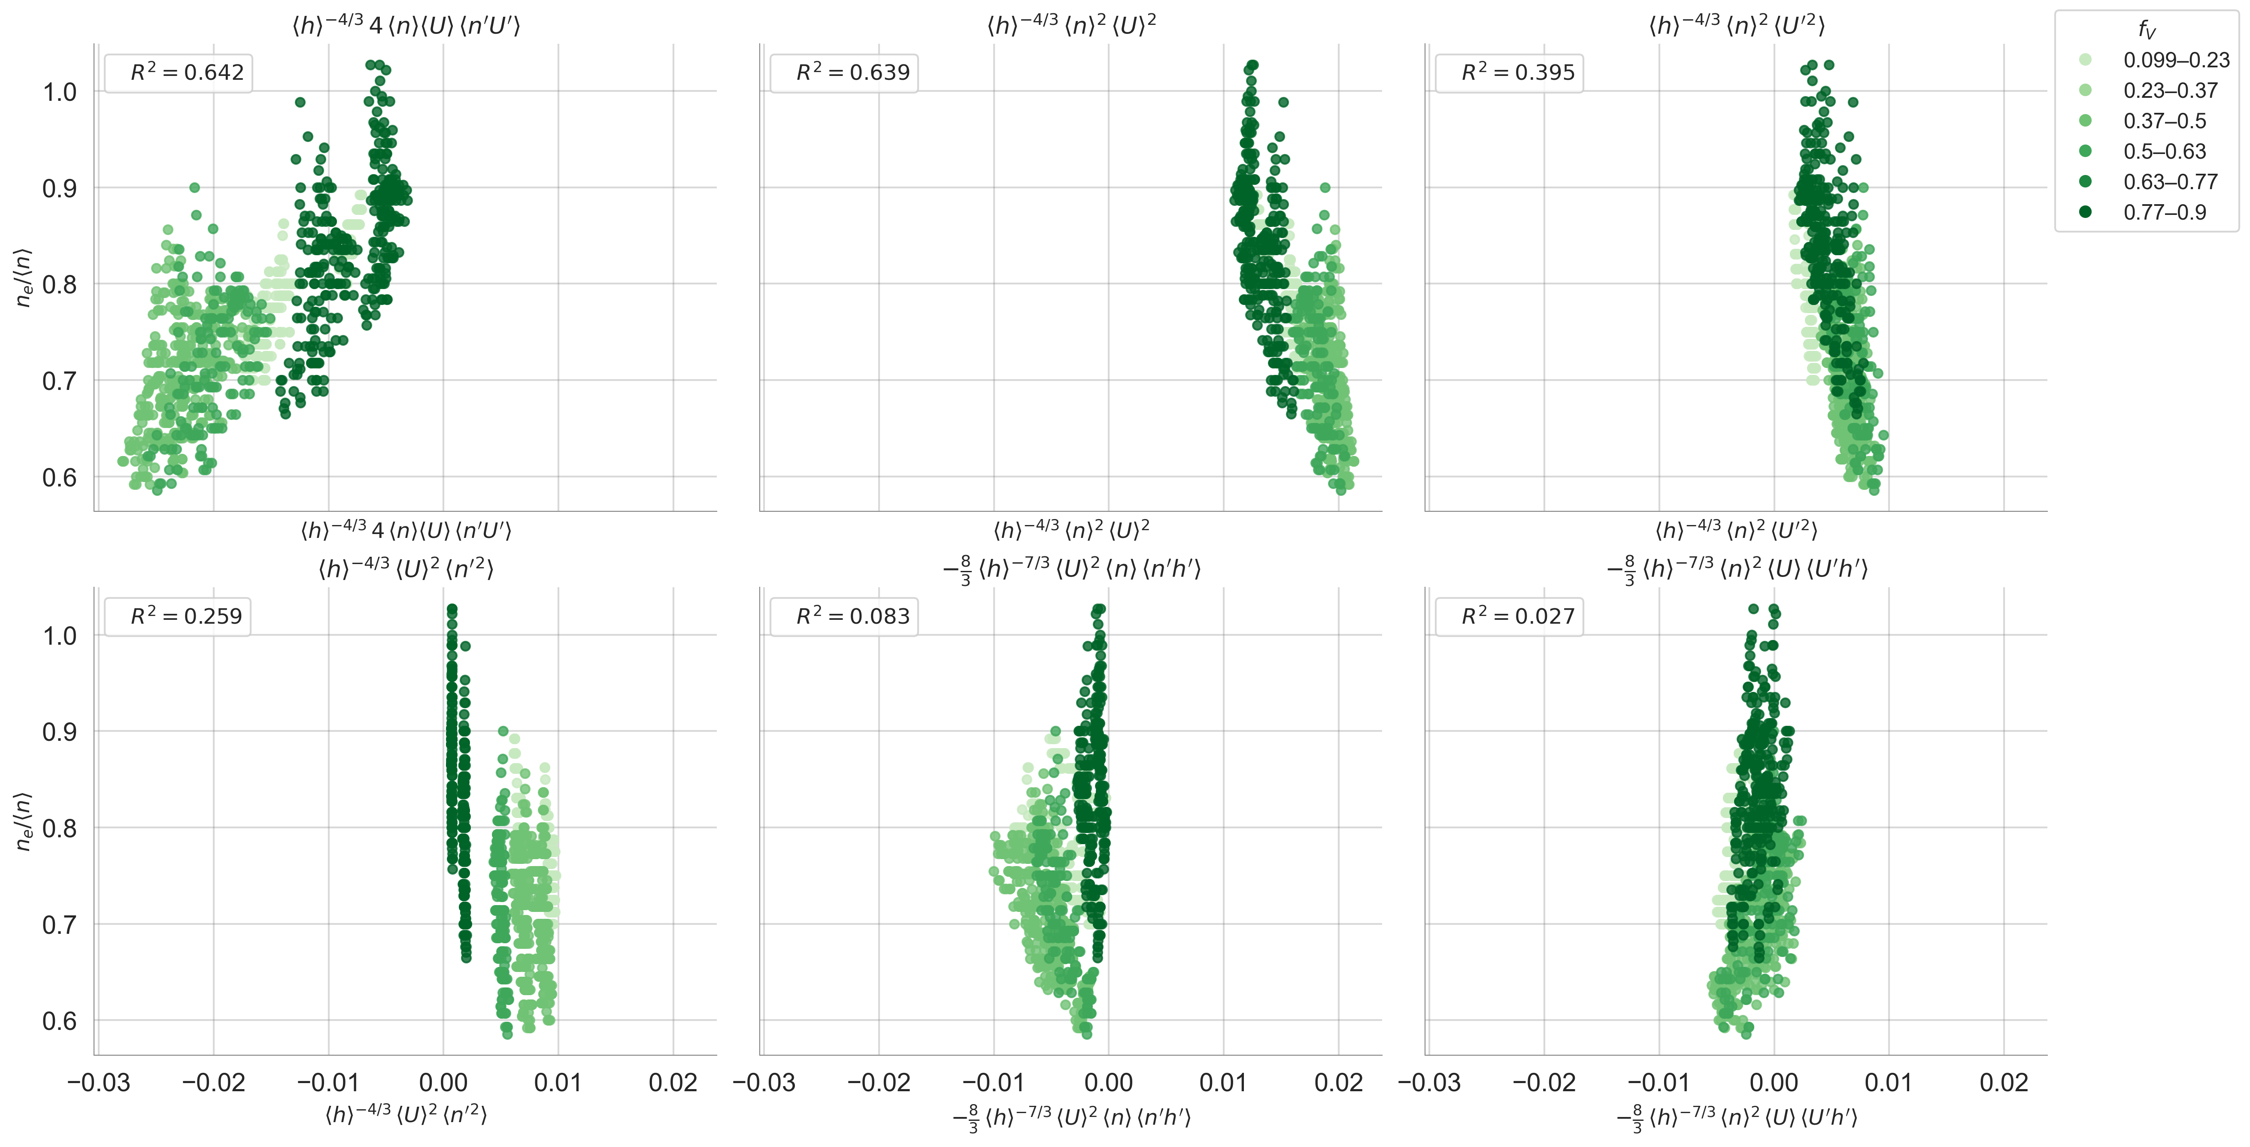

Slide 22
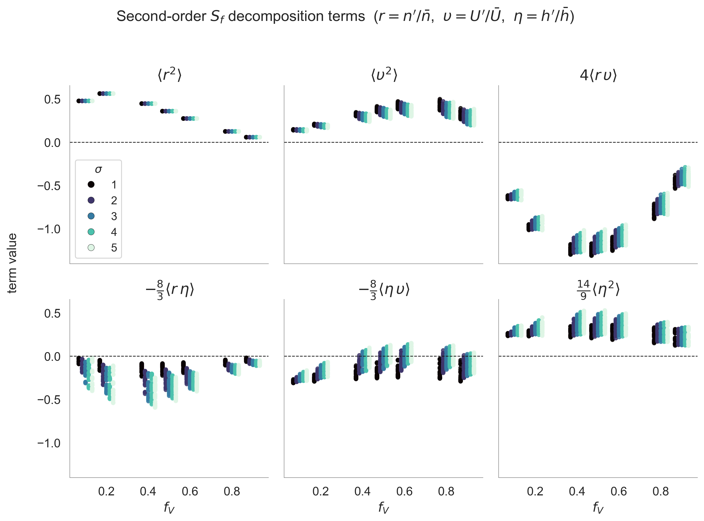

Slide 23
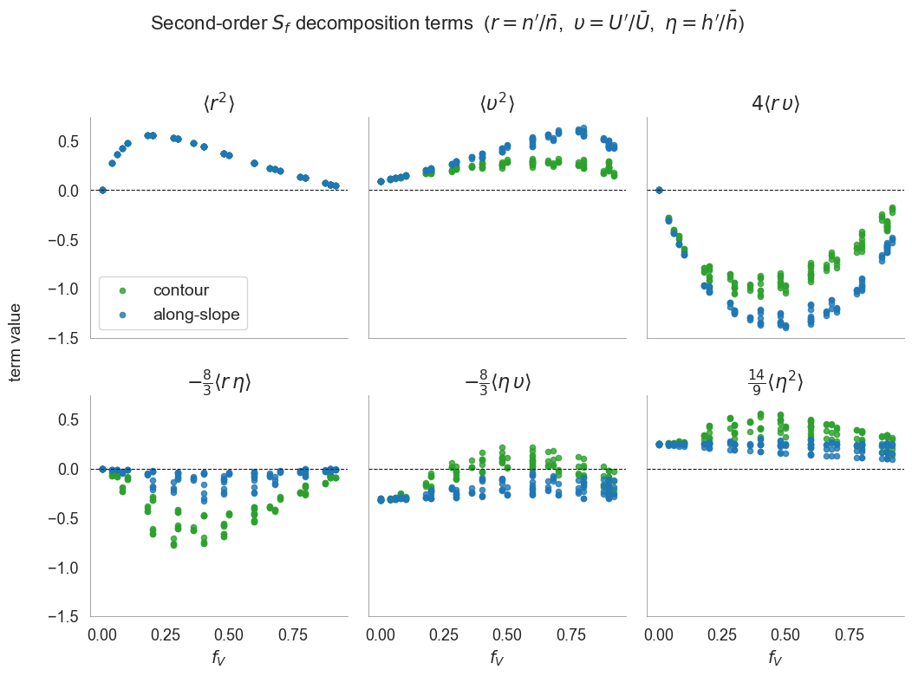

Slide 24
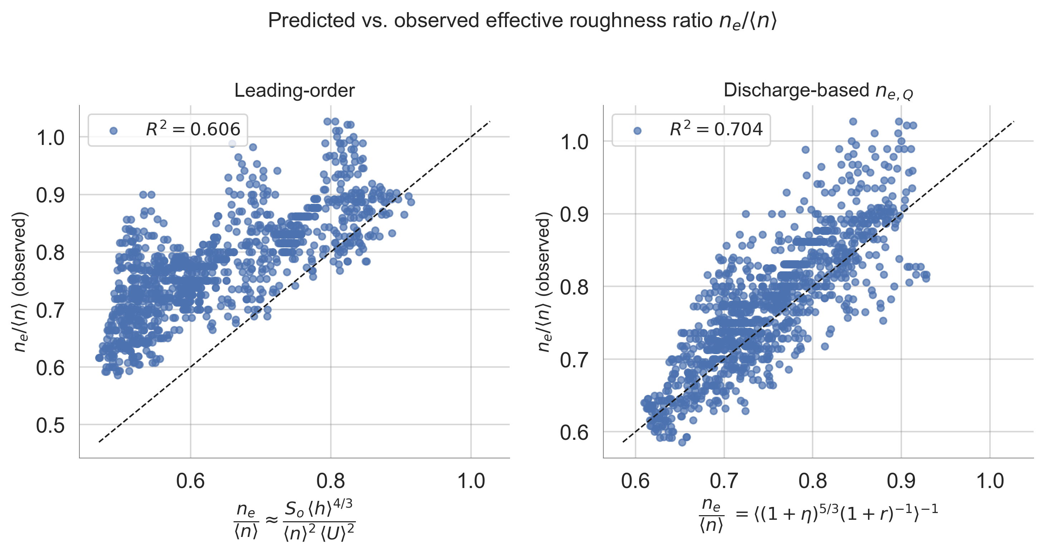

Slide 25
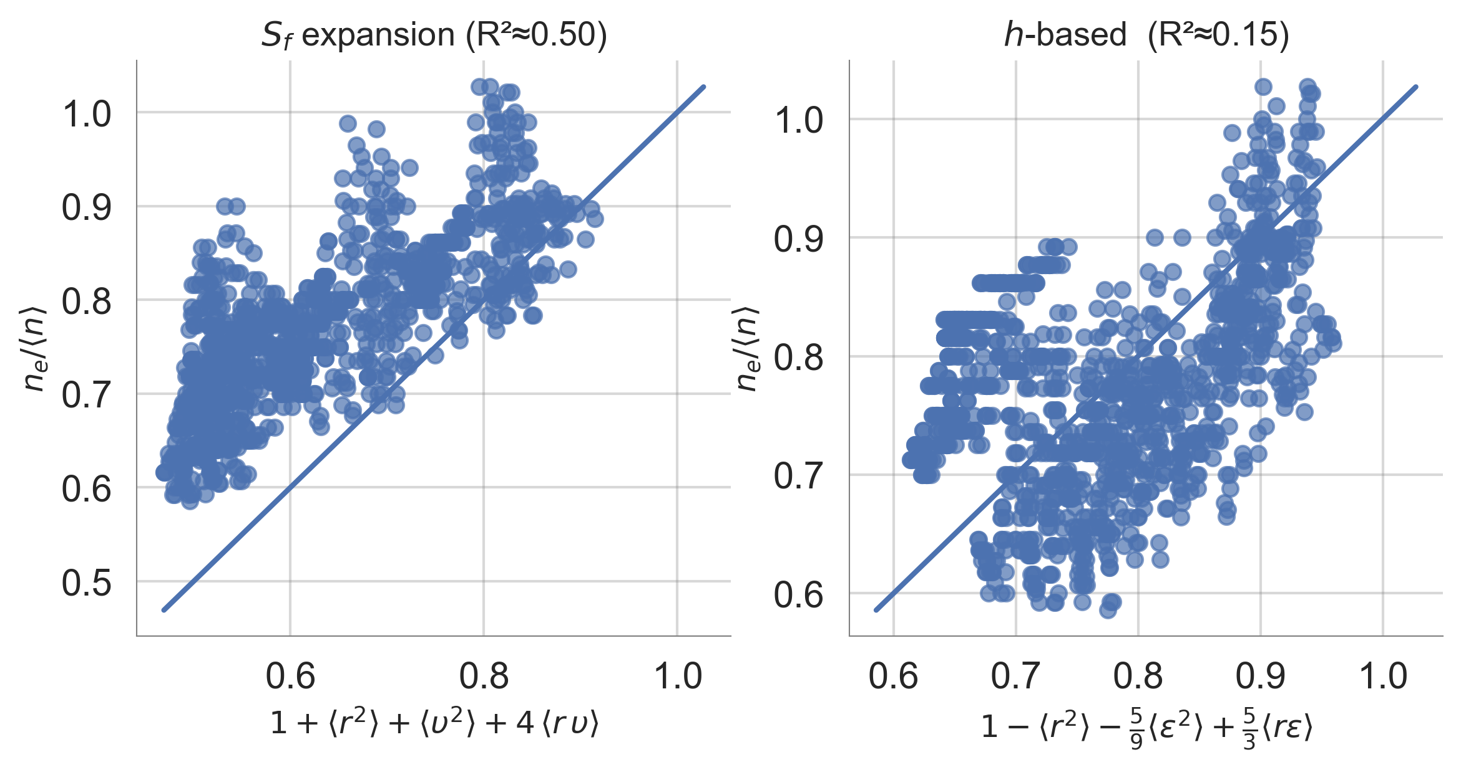

Slide 26
Questions
Flux balance → Lotter equation.
The answer depends on whether h and U are the same between bare and vegetation patches. Analogy to pipe flow.
Different answer in overland flow, because h and U are different.

Slide 27
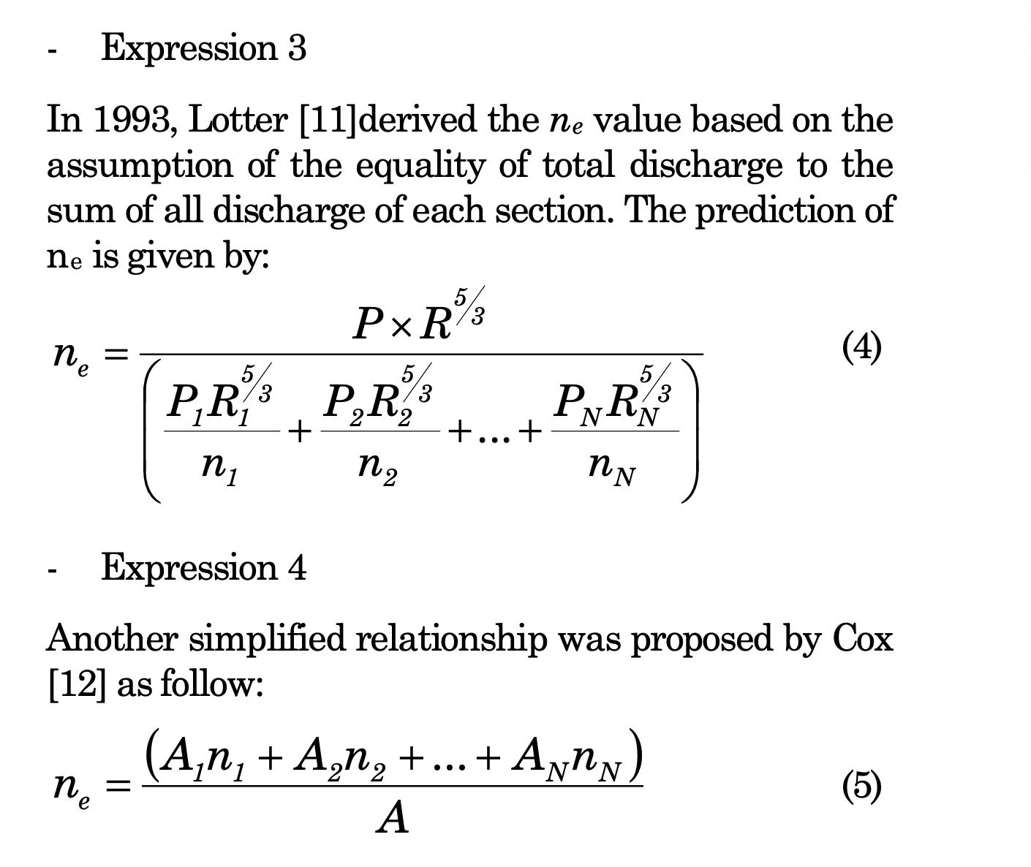
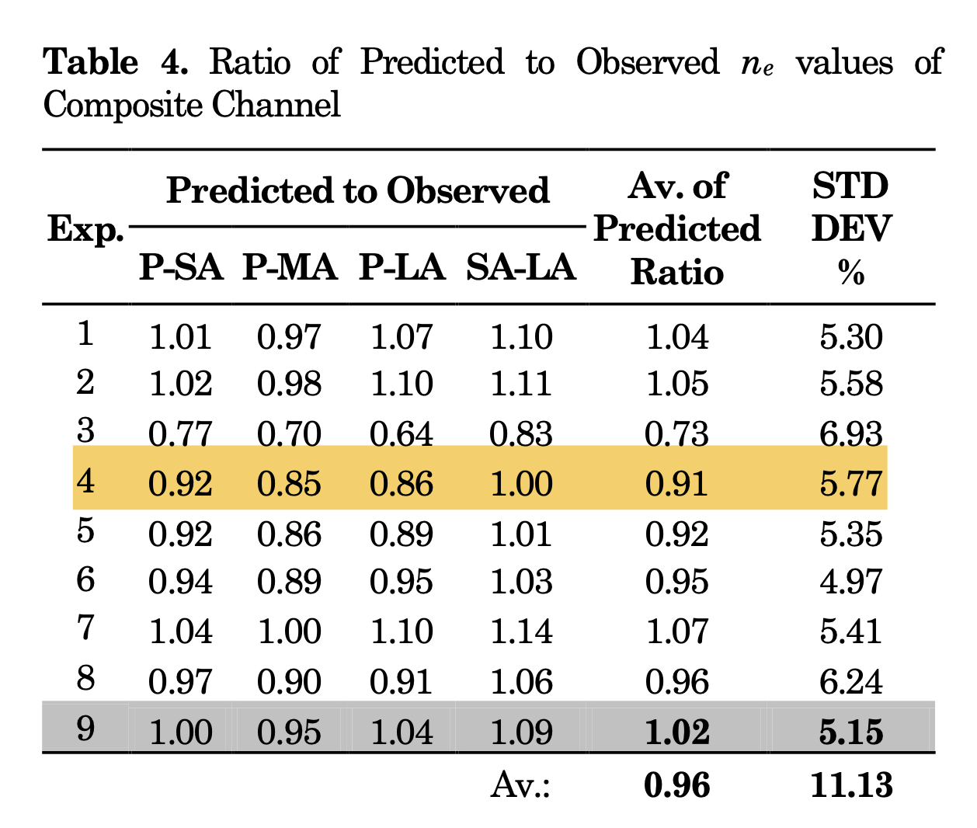

Slide 28
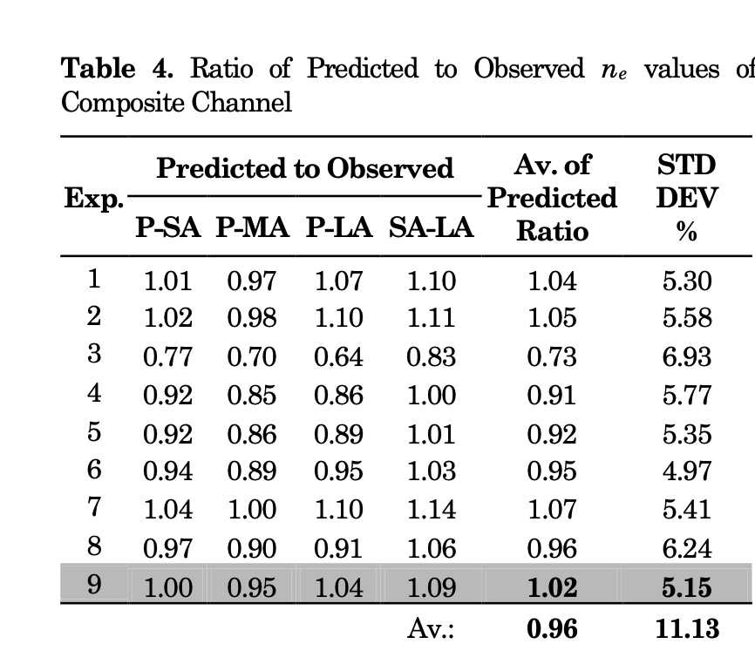
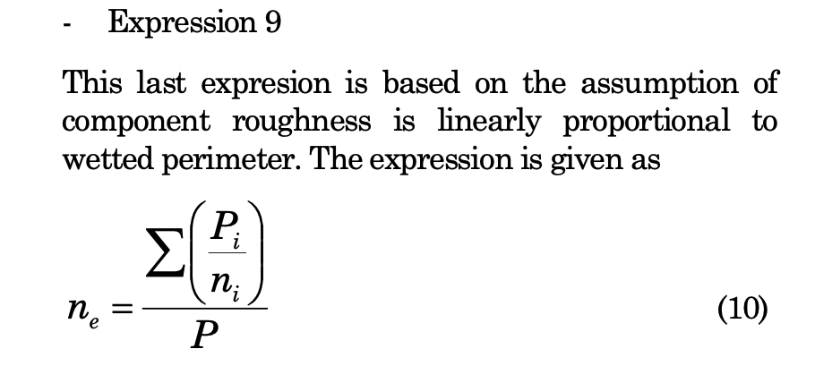
Lotter
Area average
Nah

Slide 29

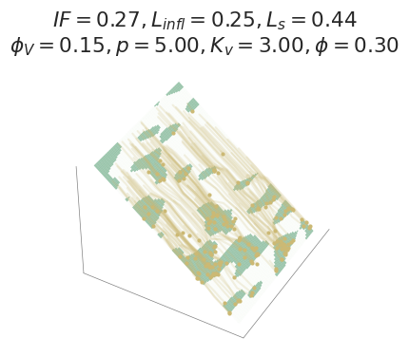
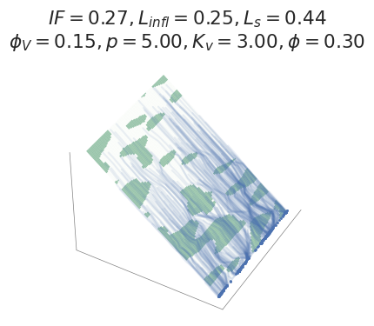
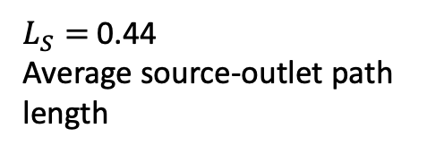
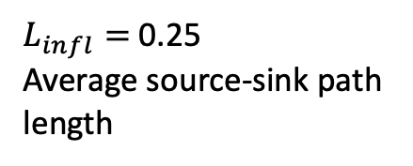
What can tracers tell us?
Tracers = ‘tagged’ water parcels advected by the flow
Paths captured tracers
Paths of escaped tracers
Some tracers are ‘captured’
Others ‘escape’ the hillslope
$L_{infl}=$ 0.25
Average source-sink path length
$L_{S}=$ 0.44
Average source-outlet path length
Notes:
To summarize these distributions of path lengths, I took the averages and normalized by the hillslope length.
Next, we'd like to understand how these lengthscales vary under changing storm and landscape conditions, and to do this,
p = 5 cm/hr, t_{R} = 60 min, Fv = 0.3, and σx = 4.
Linfl = 0.25 and Ls = 0.44

Slide 30
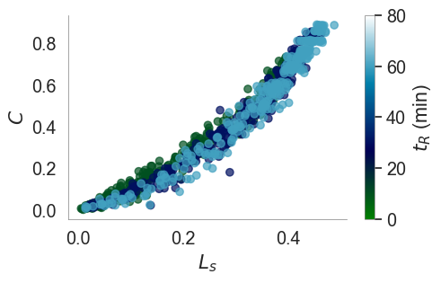
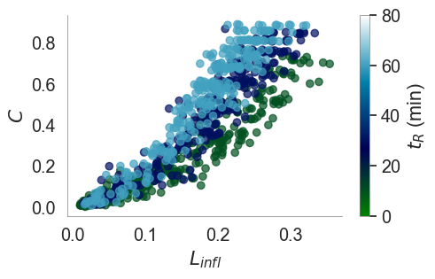
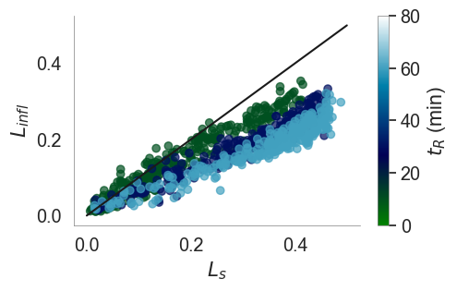



$$A$$
$$B$$
$$C$$
Runoff coefficient, C
Runoff coefficient, C
Tracers that escape
Tracers that infiltrate
Why aren’t the ‘infiltrating’ tracers traveling as far as the escaping ones?
Notes:
First, this plot shows the escaped lengthscale on the x axis, versus the runoff coefficient on the y axis, where each point represents one of the 900 simulations and colour shows the storm duration.
The relation between these variables is remarkably stationary across all the simulated variation in spatial pattern, storm and surface characteristics.
Second, this plot shows the captured lengthscale on the x axis, versus the runoff coefficient on the y axis. The relation between these variables is less stationary, with some but not all of the variation coming from the storm duration.
The final panel shows the escaped lengthscale on the x axis, versus the captured lengthscale on the y axis, showing that tracers that escape are travelling further ...
Why?
Compare paths. Tracers that escape seem to be preferentially routed around the vegetated areas.

Slide 31
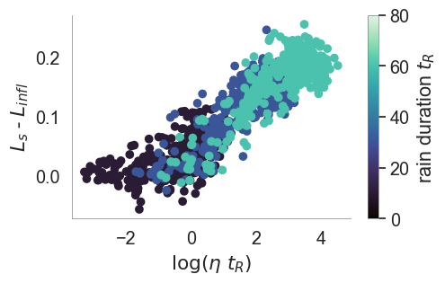
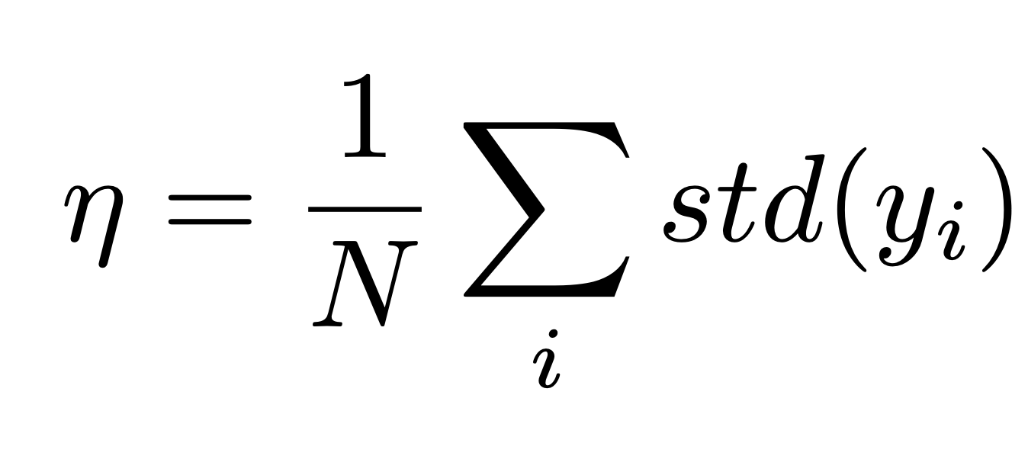
Why do the tracers that escape travel farther than those that infiltrate?
Difference in tracer travel distances
y-position
Tortuosity measure η describes tracer paths:
Tortuosity
Storm duration
Notes:
To look at this more closely, I created a tortuosity metric, which describes the windiness of the tracers, and is computed as the mean standard deviation of the tracer positions in the across-slope direction.
and this provides some insights.
This plot shows the tortuosity adjusted by rainfall duration on the x axis,
and the difference in lengthscales on the y axis.
and what we see is that by introducing tortuosity,
the difference in lengthscale seems to be collapsed,
and this collapse is explained by rainfall duration and tortuosity.

Slide 32
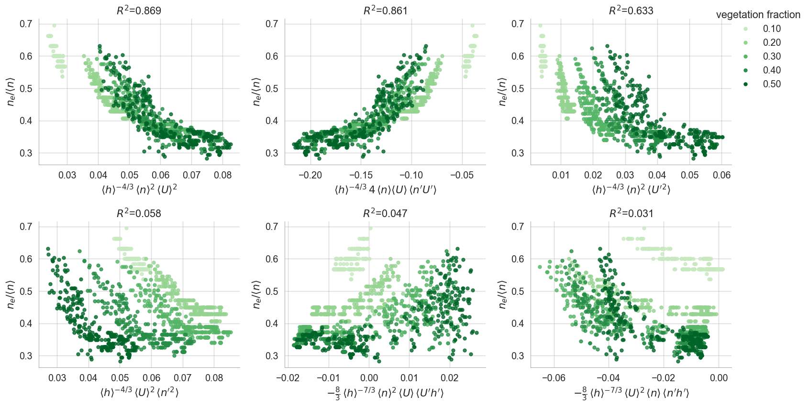

Slide 33
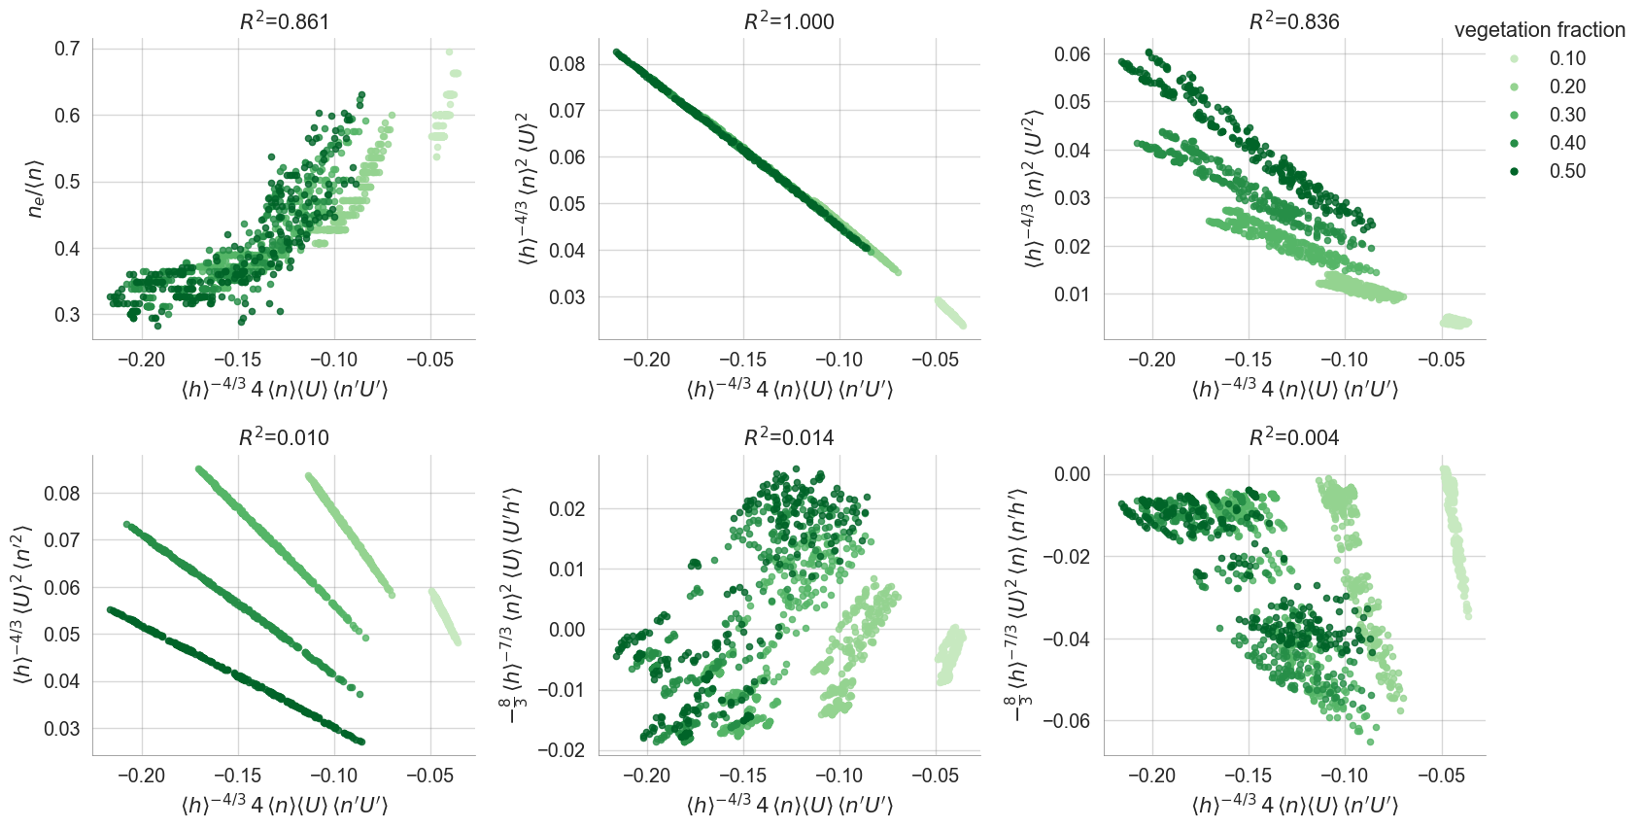

Slide 34
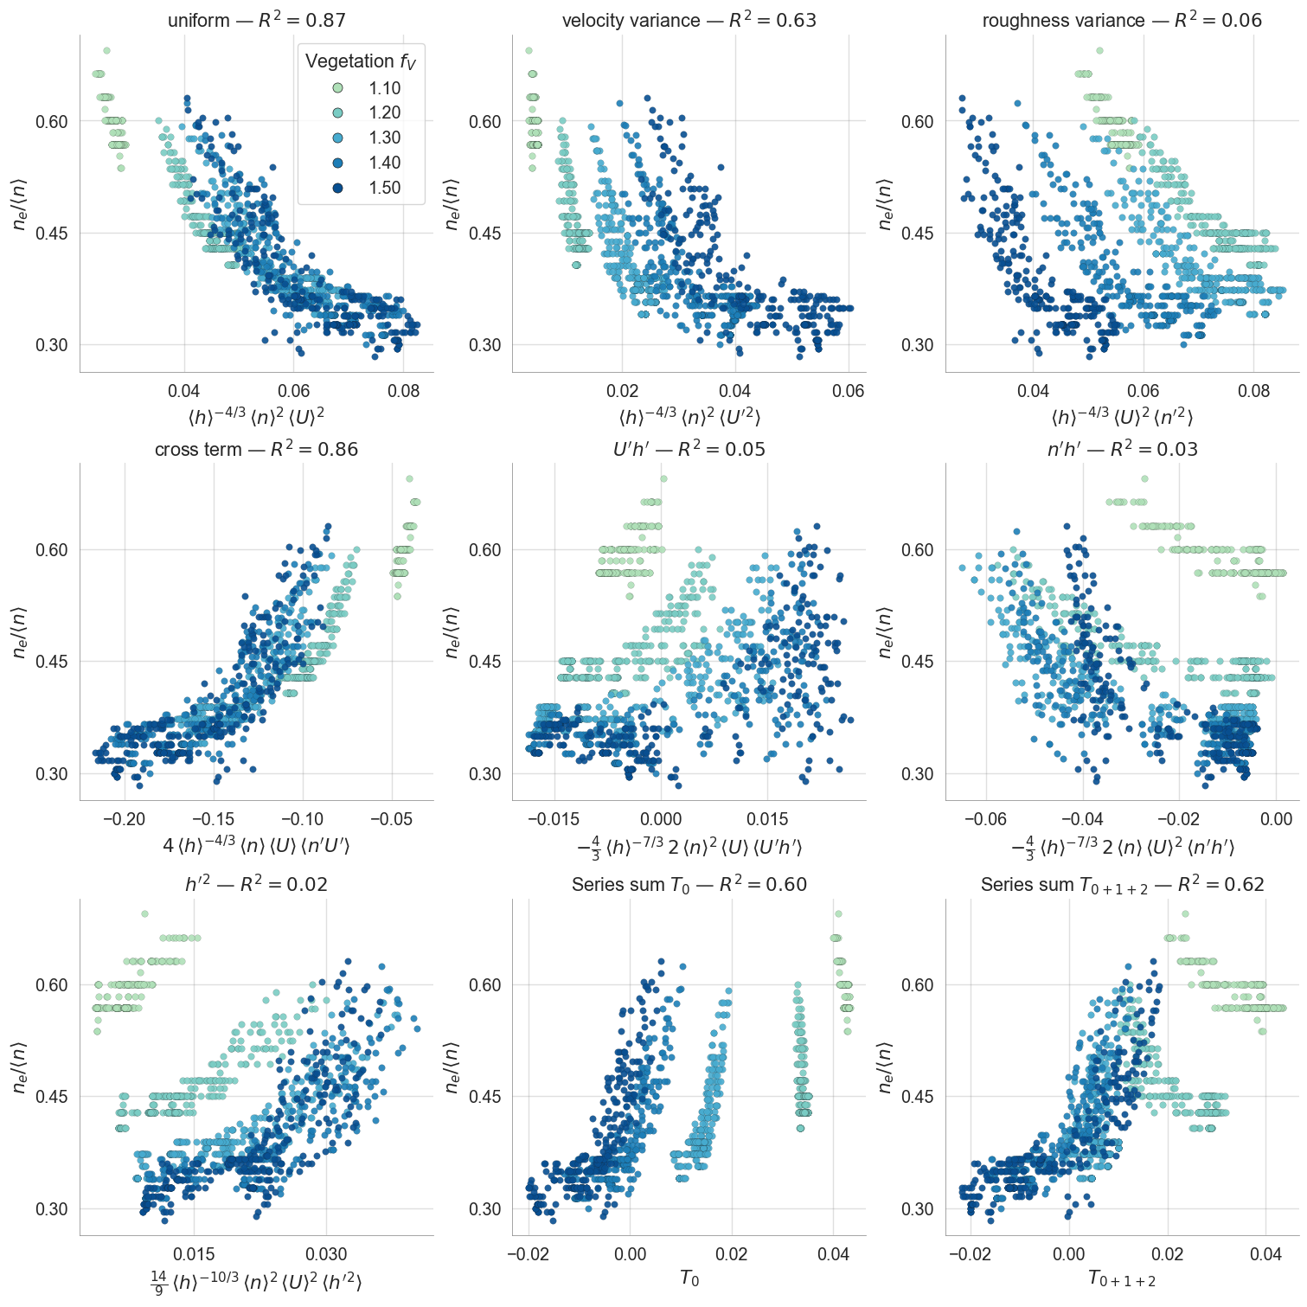

Slide 35
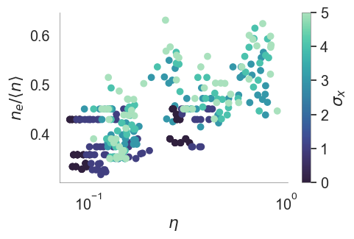

Slide 36
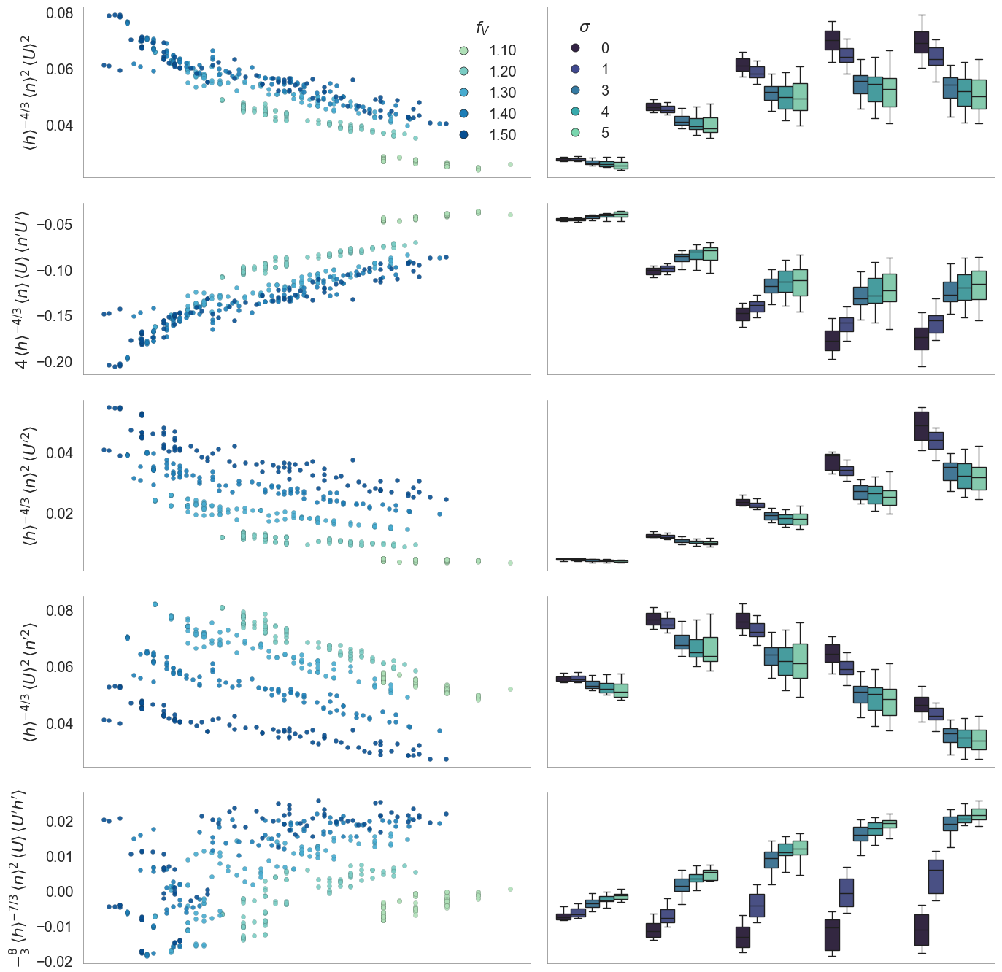

Slide 37
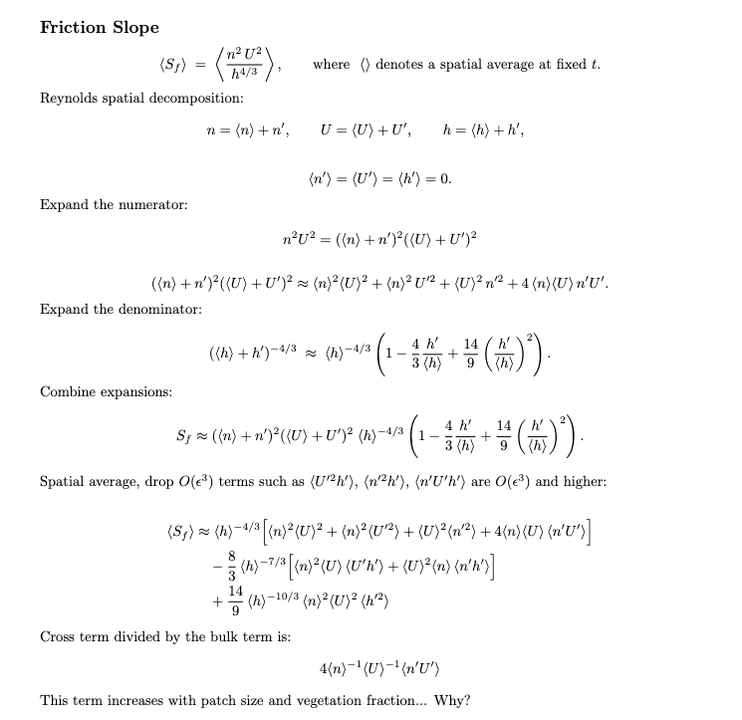

Slide 38
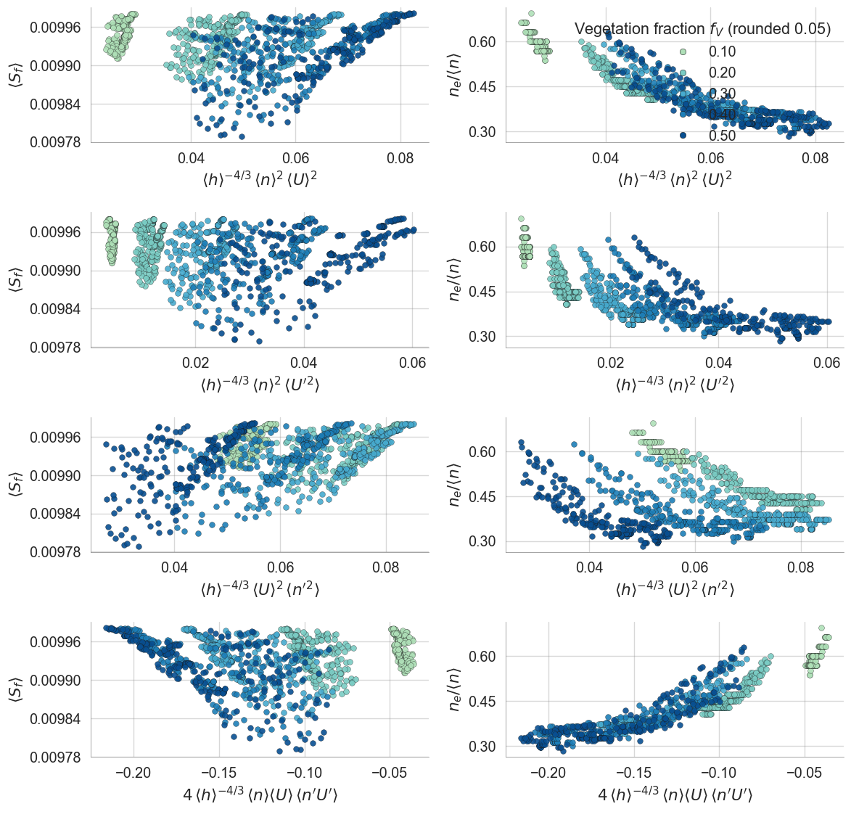

Slide 39
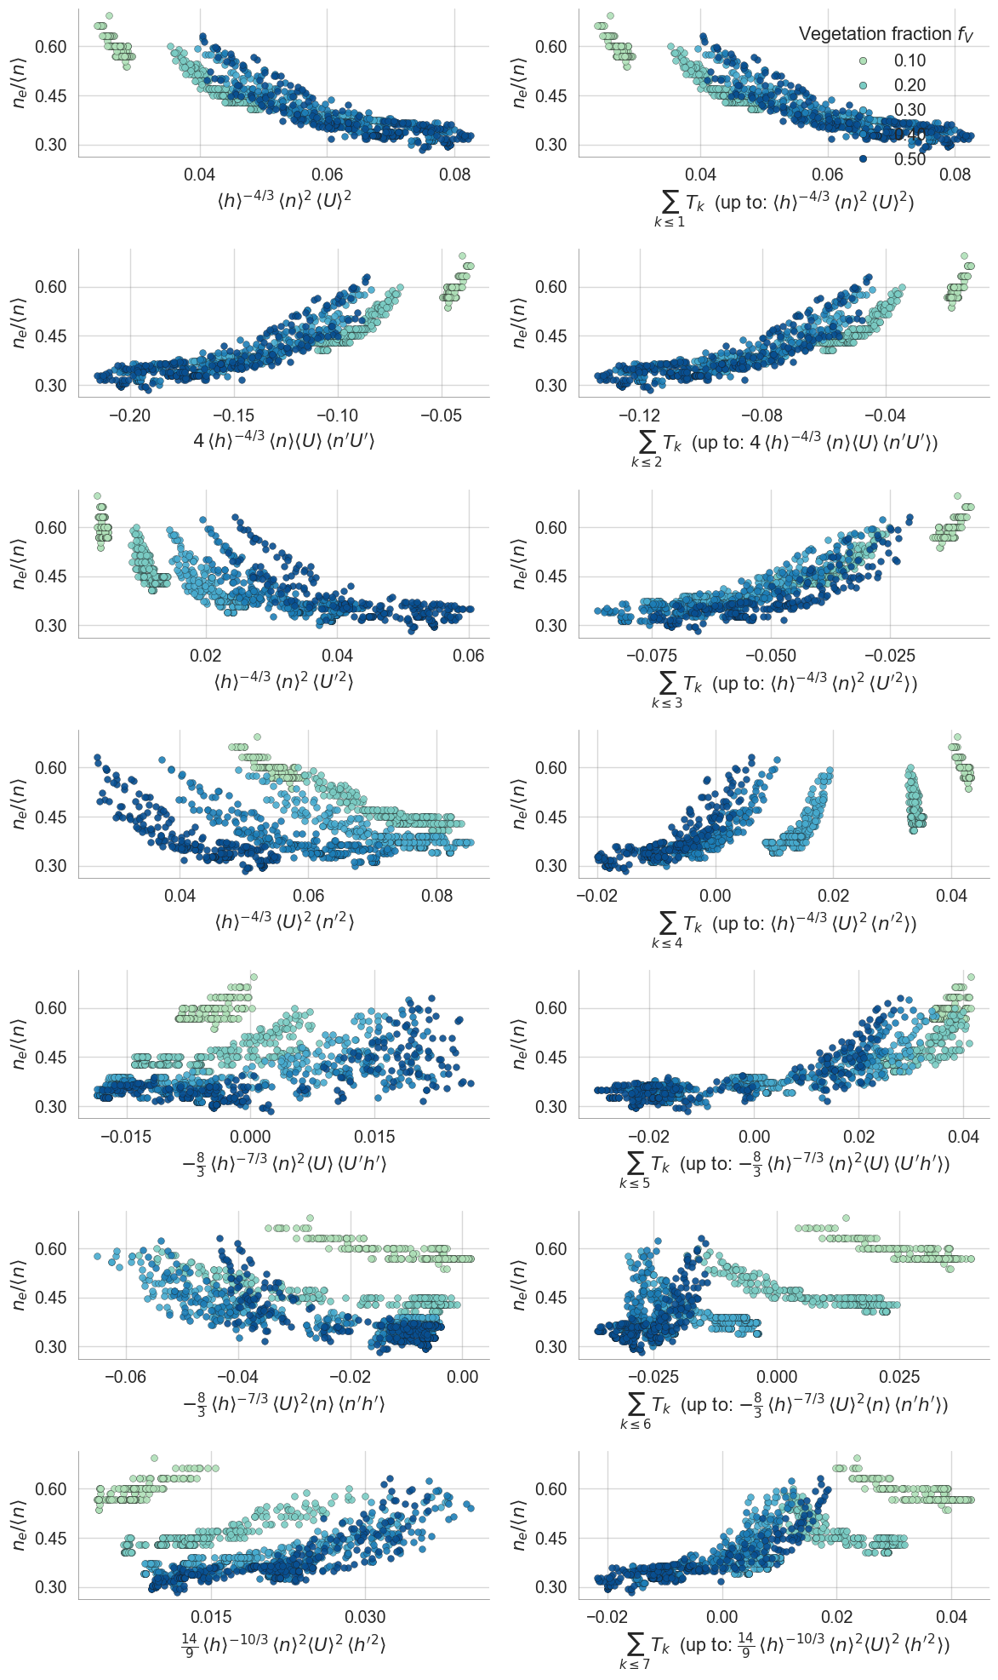

Slide 40
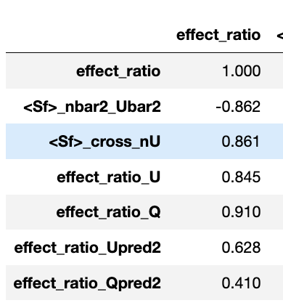
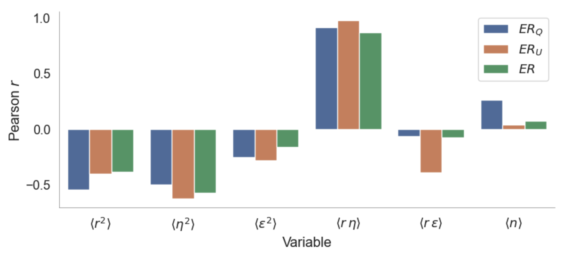


Discharge expansion:
Spatial expansion:
Negative correlation between

Slide 41


Slide 42


Slide 43


Slide 44


